Slide 1


Protective equipment – then and now
What did healthcare look like in Shakespeare’s time?

Slide 2


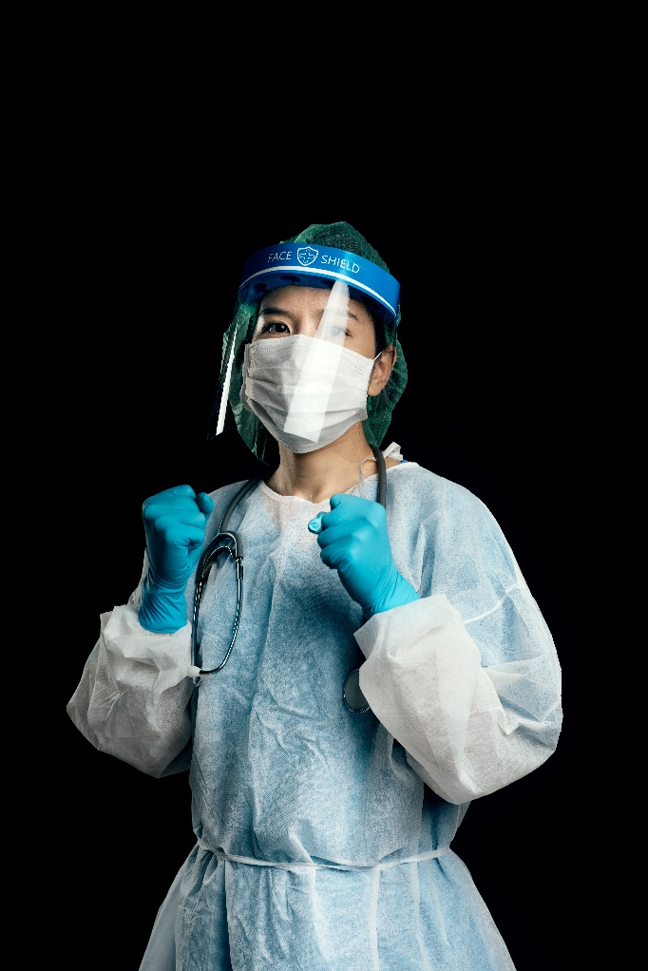
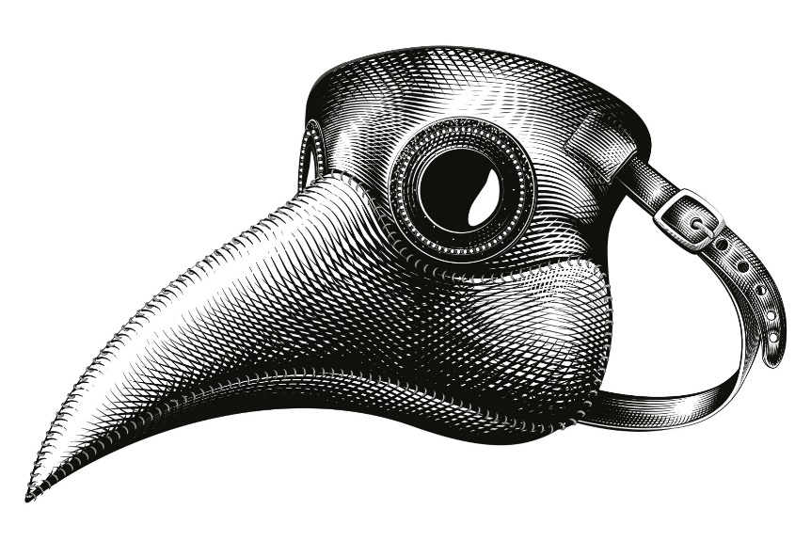
Would you rather?
Be looked after by a doctor wearing this…
Or this?

Slide 3
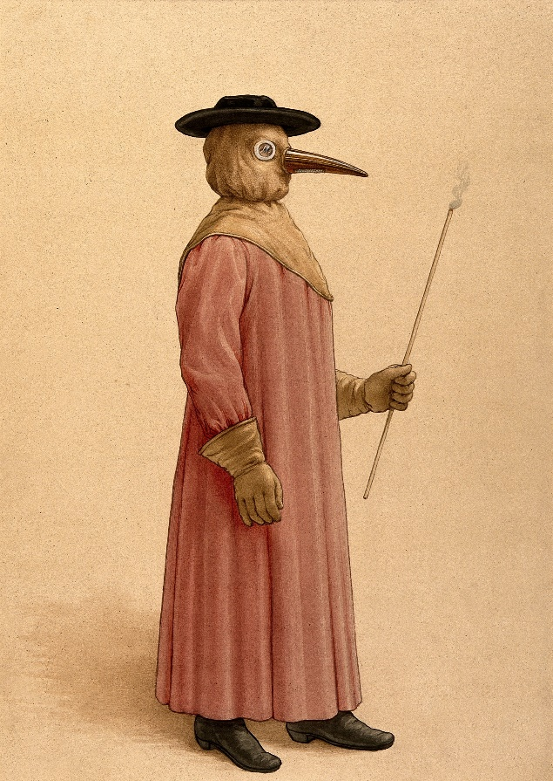
Plague doctors
The plague doctor’s outfit might look very strange to us, but not so long ago we might have thought a doctor in PPE looked very unusual too.
Image: A physician wearing a 17th century plague preventive. Credit: Wellcome Collection. Attribution 4.0 International (CC BY 4.0)

Slide 4
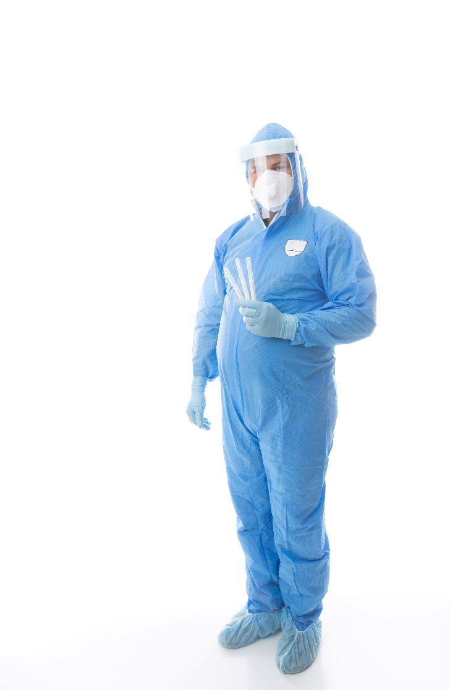
Modern doctors
Because of Coronavirus we have got used to seeing doctors and health workers wearing masks and other protective clothing.
People in Shakespeare’s time would have been used to seeing plague doctors.

Slide 5


Same or different?
What are the differences and similarities between plague doctors and modern doctors in PPE?
Image: A physician wearing a 17th century plague preventive. Credit: Wellcome Collection. Attribution 4.0 International (CC BY 4.0)

Slide 6
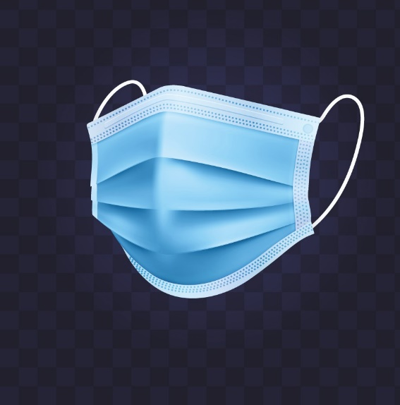
Seeing a doctor
During the Coronavirus pandemic doctors have had to make changes to the way they see patients. That’s because Coronavirus is very catching.
During the pandemic instead of going to visit a doctor’s surgery, patients usually telephone their doctor first. When doctors see their patients they wear masks and they ask adults and older children to do the same.

Slide 7

A plague doctor visit
Bubonic plague in Shakespeare’s time was also very infectious.
Plague doctors rarely went inside plague infected homes or touched patients. Instead they would stand back and poke patients with a stick – a sort of Tudor version of social distancing!
Image: A physician wearing a 17th century plague preventive. Credit: Wellcome Collection. Attribution 4.0 International (CC BY 4.0)

Slide 8

How do you feel?
How does it make you feel when you see people in masks or protective clothing?

Slide 9
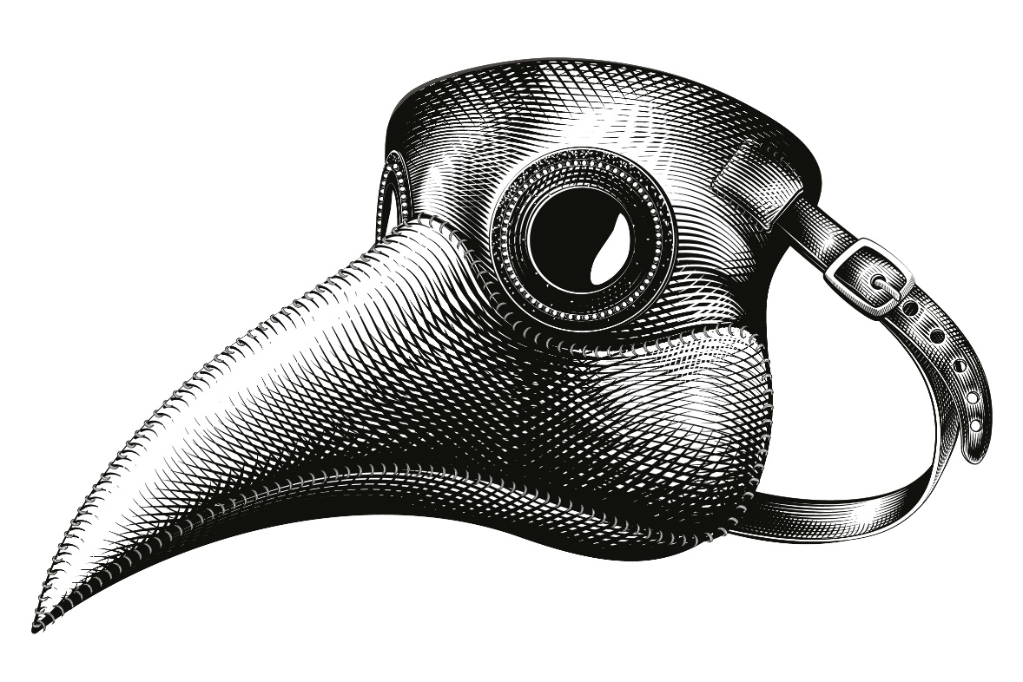
Imagining the past
How do you think people in the seventeenth century felt when they saw a plague doctor?

Slide 10
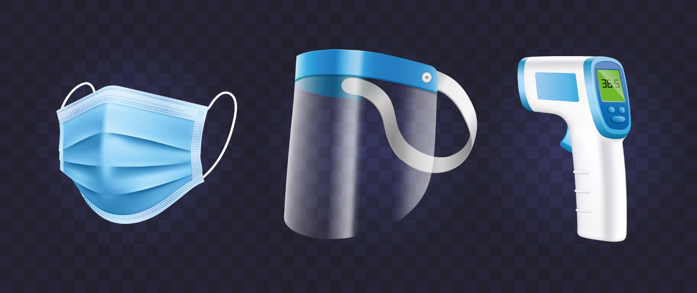
Medical knowledge
Find out about the equipment in this picture and talk about how it can keep you safe.
Although some things are similar, today we have better knowledge and medicines and we are much better at understanding how to keep safe.

