Slide 1



Creating a Shakespeare portrait
With children’s illustrator Petr Horacek

Slide 2


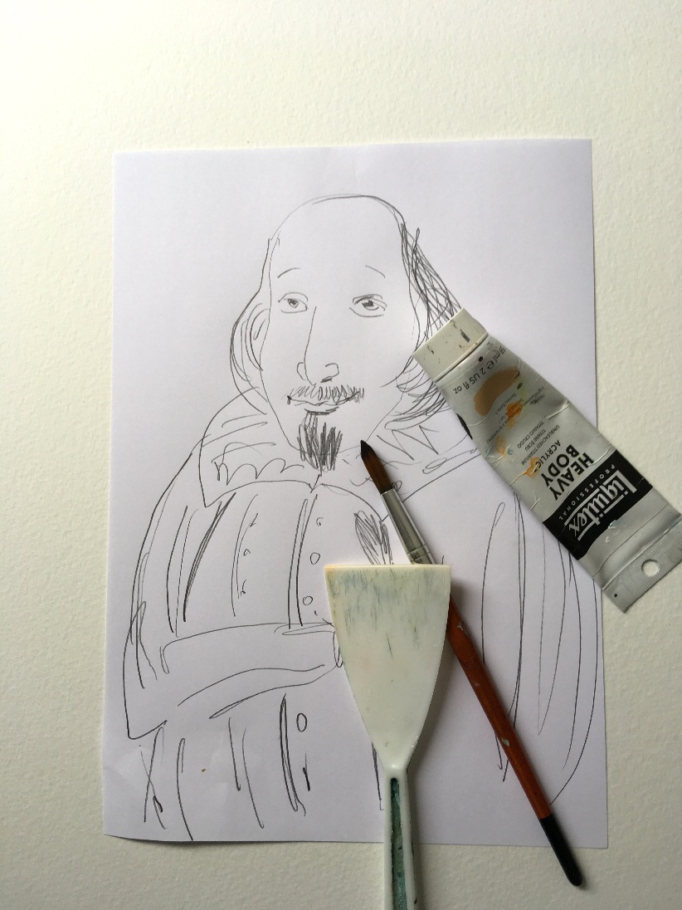
Creating a Shakespeare portrait
1. Do a drawing of William Shakespeare

Slide 3
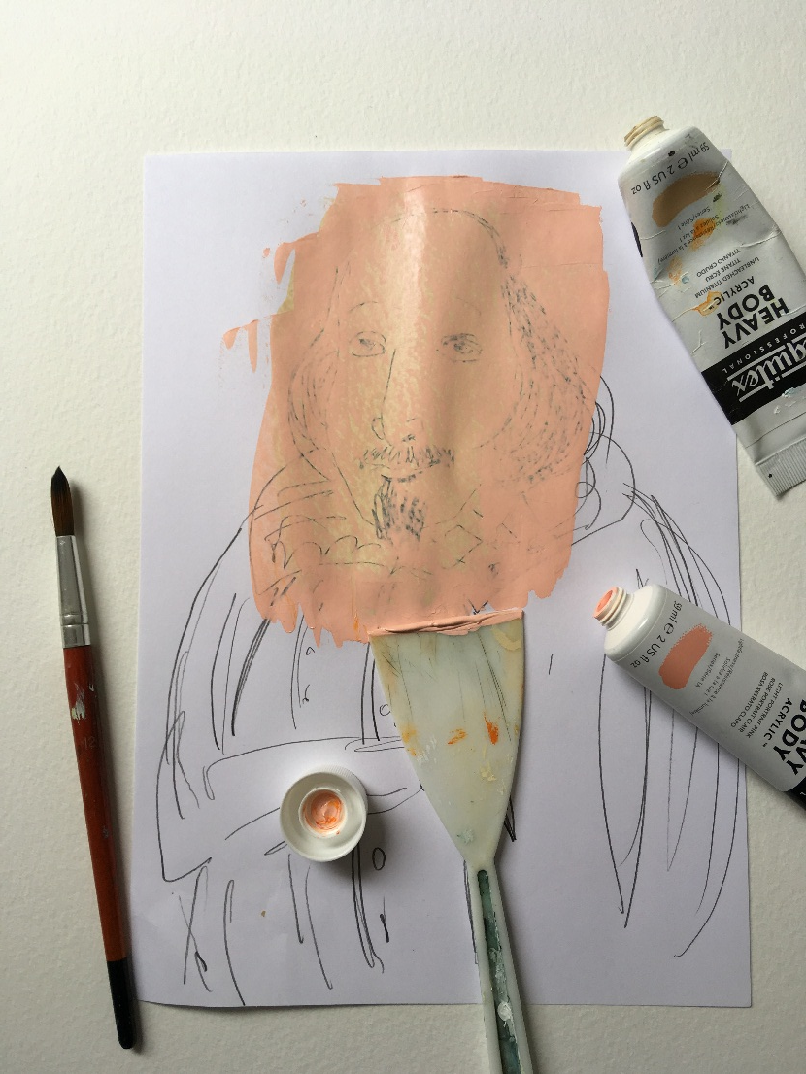
Creating a Shakespeare portrait
2. Paint over his face.

Slide 4
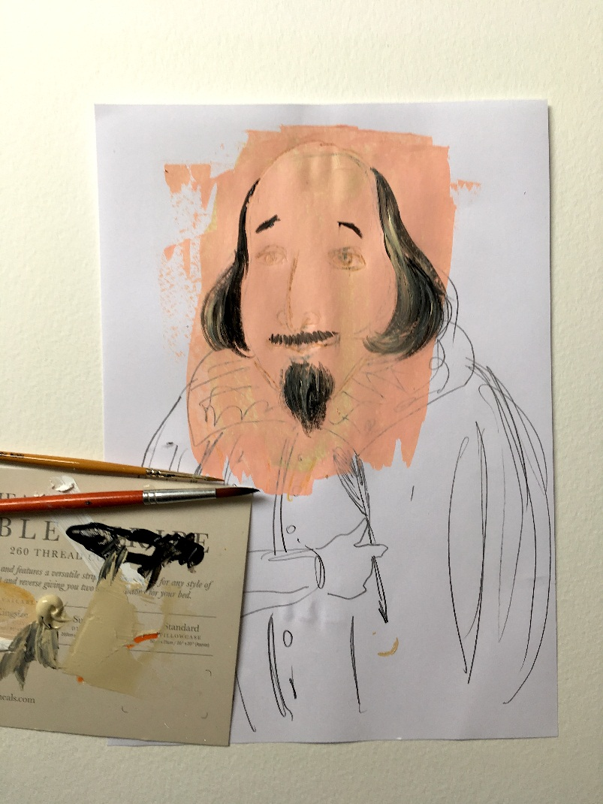
Creating a Shakespeare portrait
3. Paint his hair and beard.

Slide 5
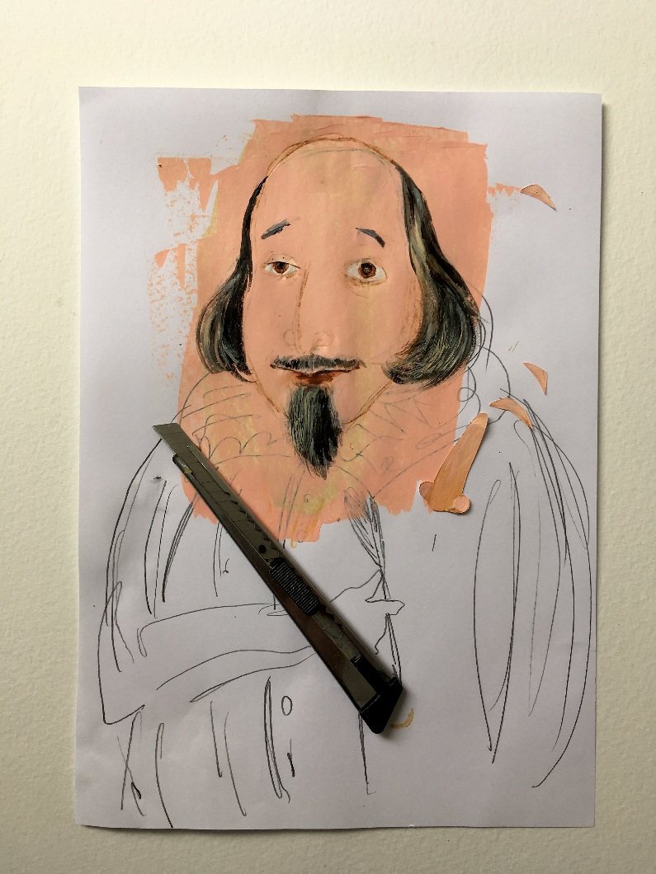
Creating a Shakespeare portrait
4. Give him some nice eyes.

Slide 6
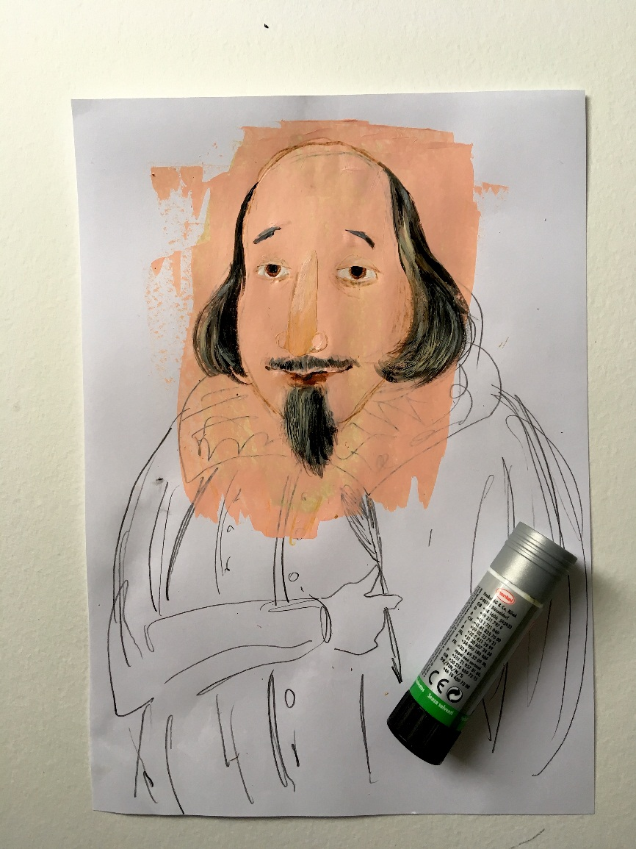
Creating a Shakespeare portrait
5. Add his nose and eyebrows using collage.

Slide 7
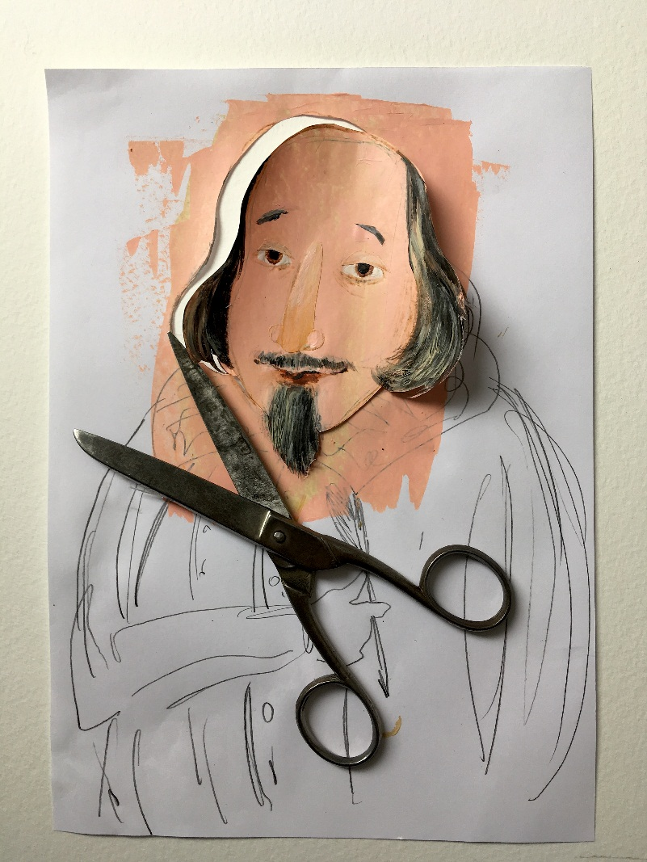
Creating a Shakespeare portrait
6. Cut out William’s head and keep it to one side. You will need it later.

Slide 8
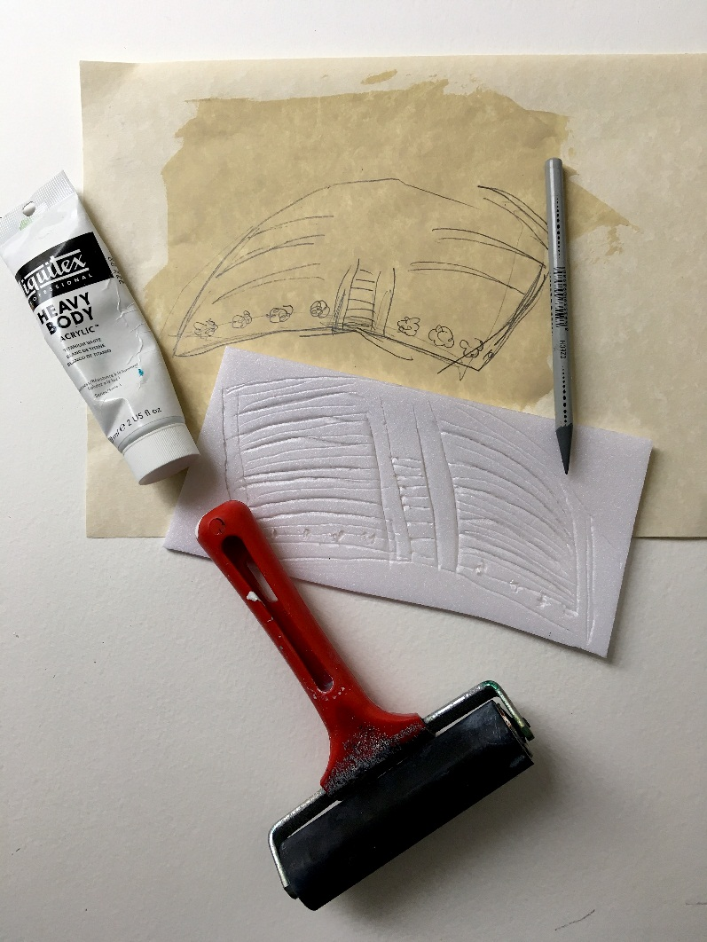
Creating a Shakespeare portrait
7. Make the collar of his coat.

Slide 9
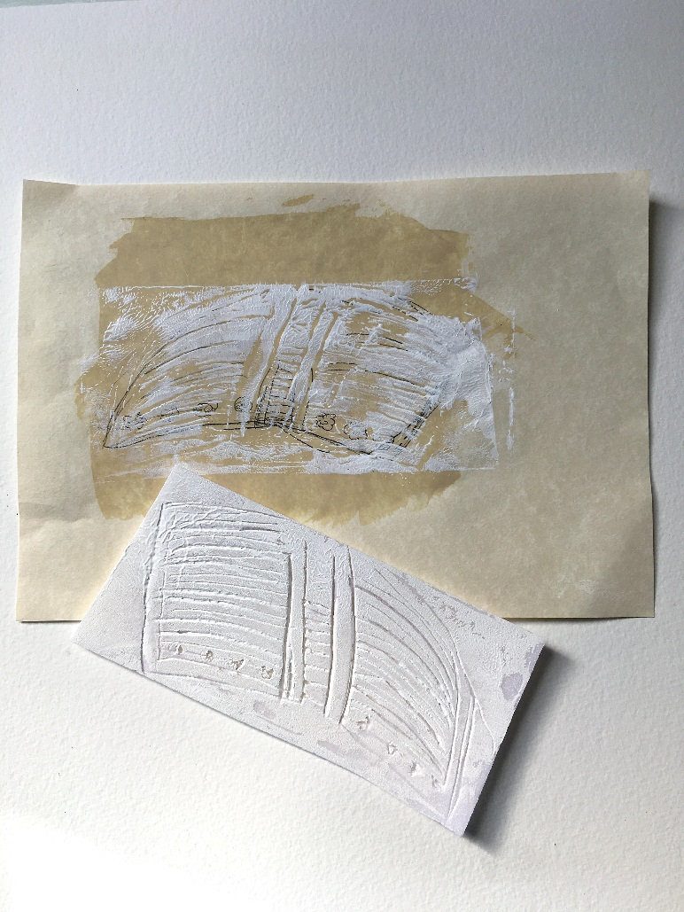
Creating a Shakespeare portrait
8. You can use patterned paper, or just print your own by using a polystyrene sheet and scratching into it with a pencil.

Slide 10
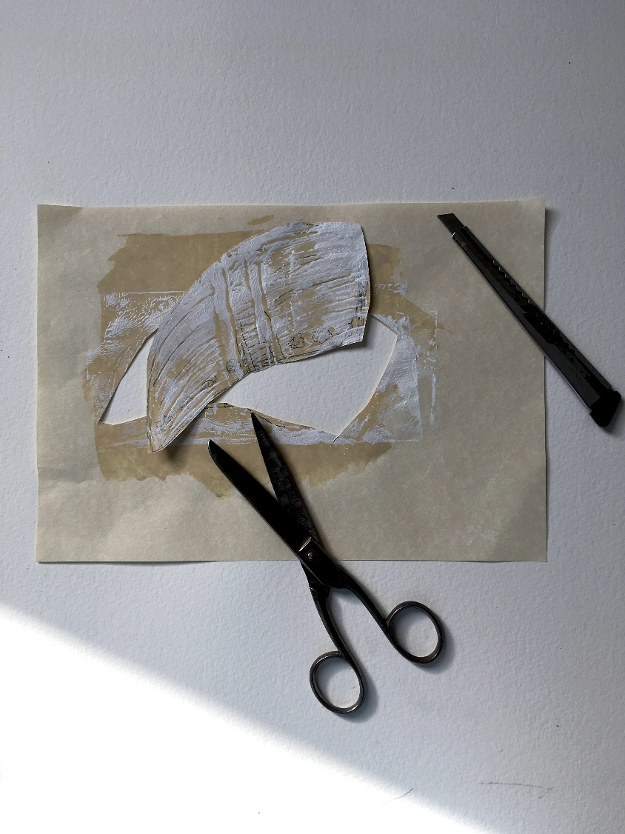
Creating a Shakespeare portrait
9. Cut the collar out.

Slide 11
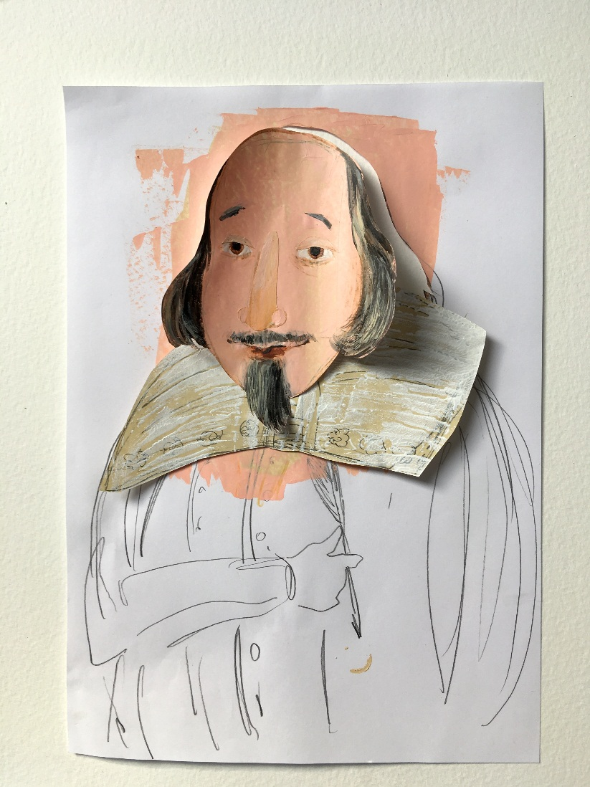
Creating a Shakespeare portrait
10. It’s looking good!

Slide 12
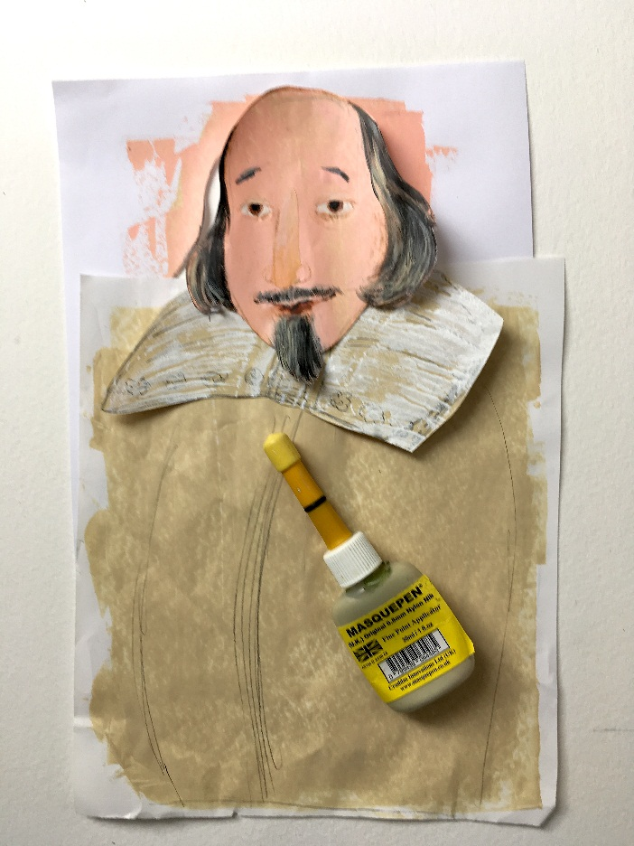
Creating a Shakespeare portrait
11. Make the coat. I used masking fluid, but you can use paint and crayons. You will need to draw the patterns on the coat first, using white crayons.

Slide 13
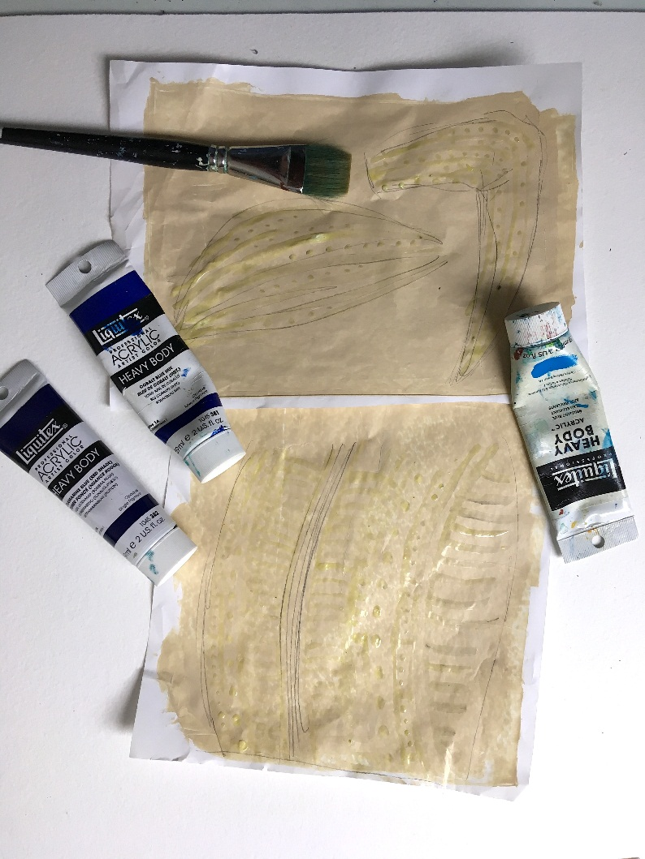
Creating a Shakespeare portrait
12. Create the sleeves too by drawing patterns with white crayons.

Slide 14
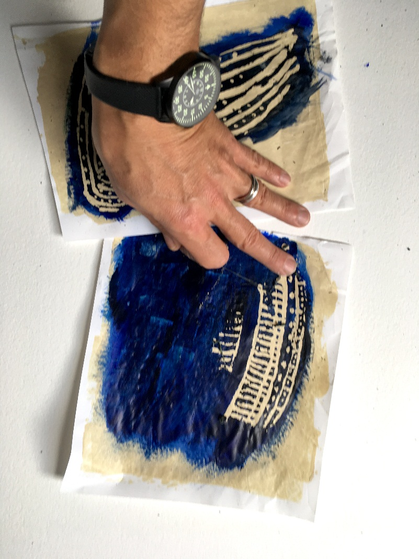
Creating a Shakespeare portrait
13. Paint over the top with blue or dark paint. The white crayon patterns will ‘resist’ the paint and show through.

Slide 15
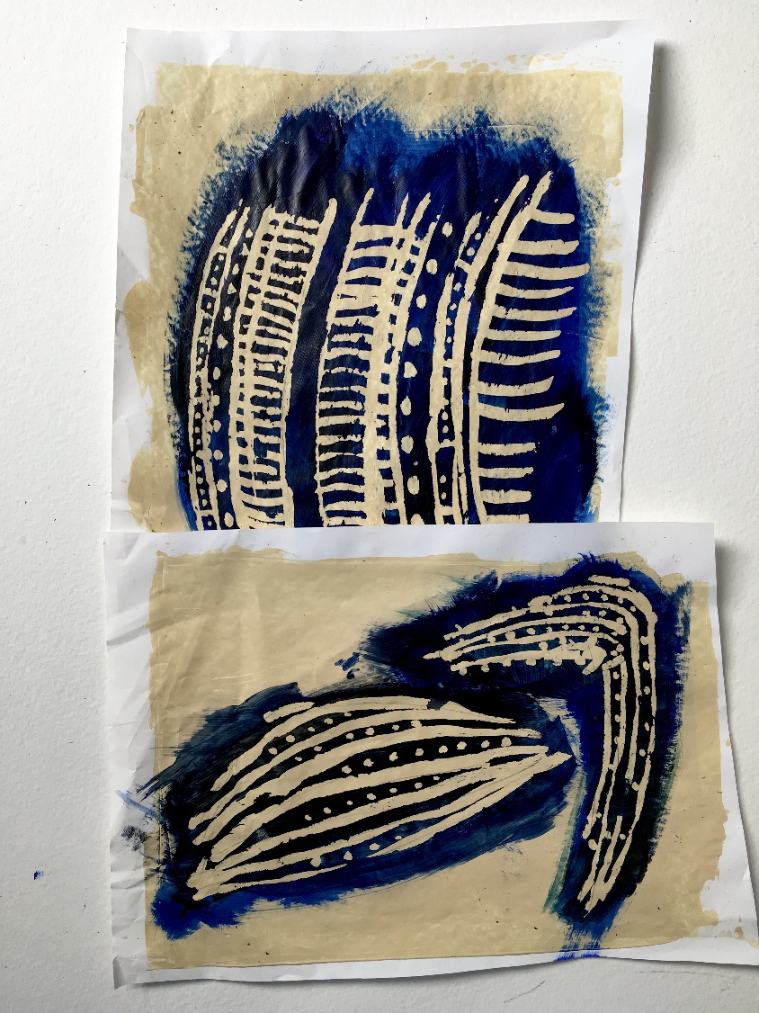
Creating a Shakespeare portrait
14. Nice patterns!

Slide 16
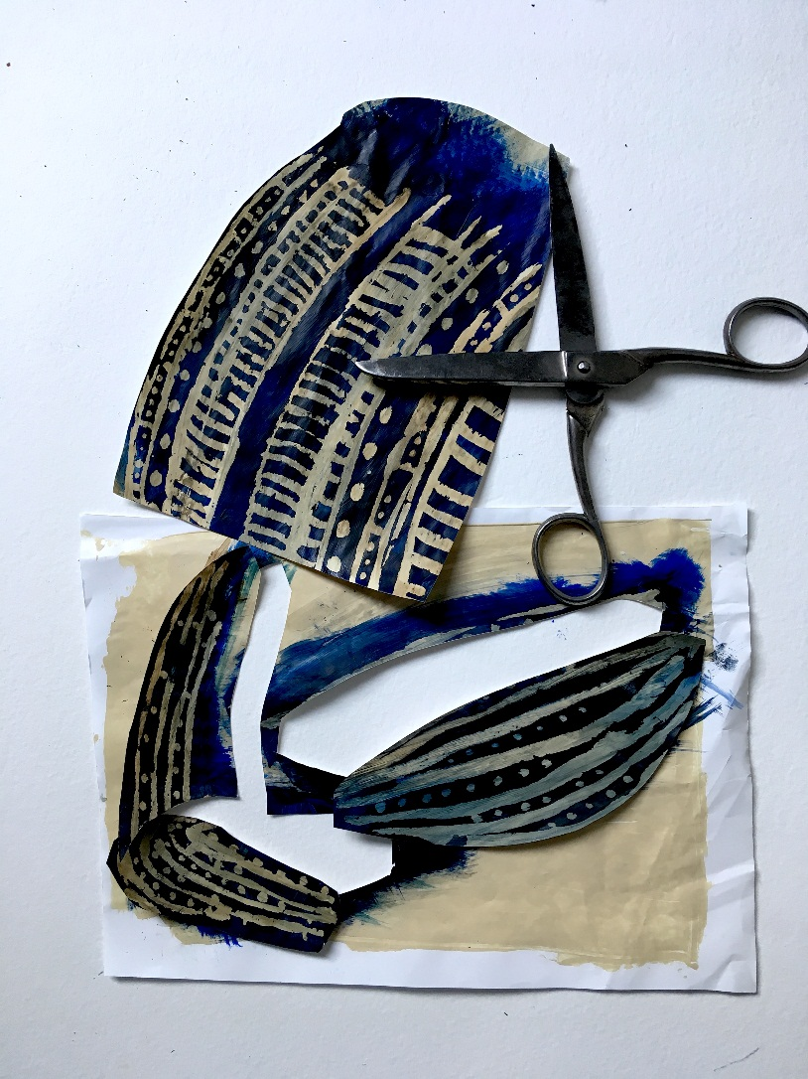
Creating a Shakespeare portrait
15. Cut out the coat and sleeves.

Slide 17
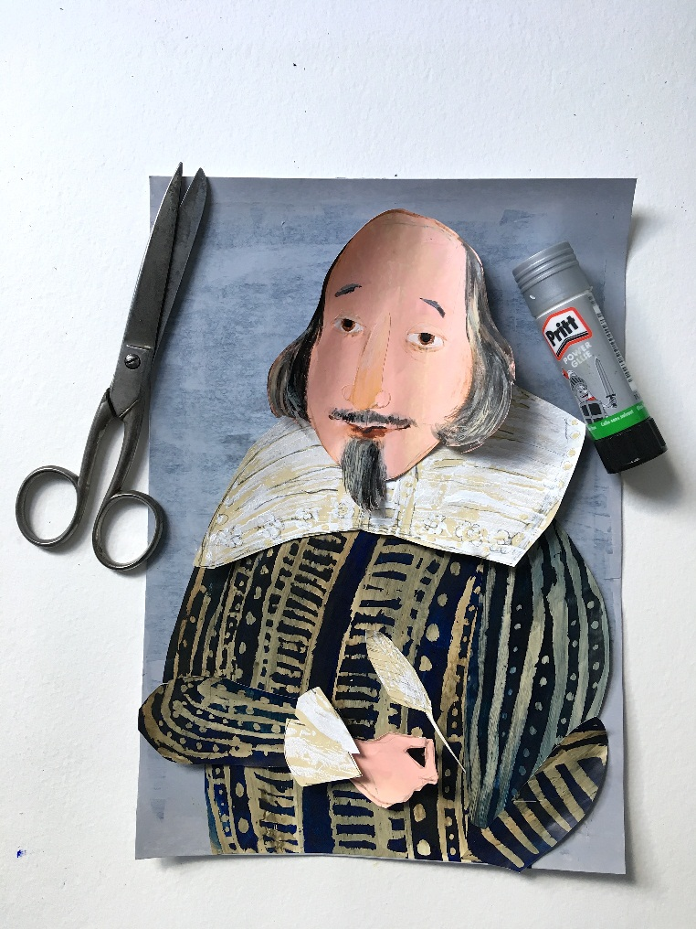
Creating a Shakespeare portrait
16. Make the final adjustments and finish the collage by sticking things into place.

Slide 18
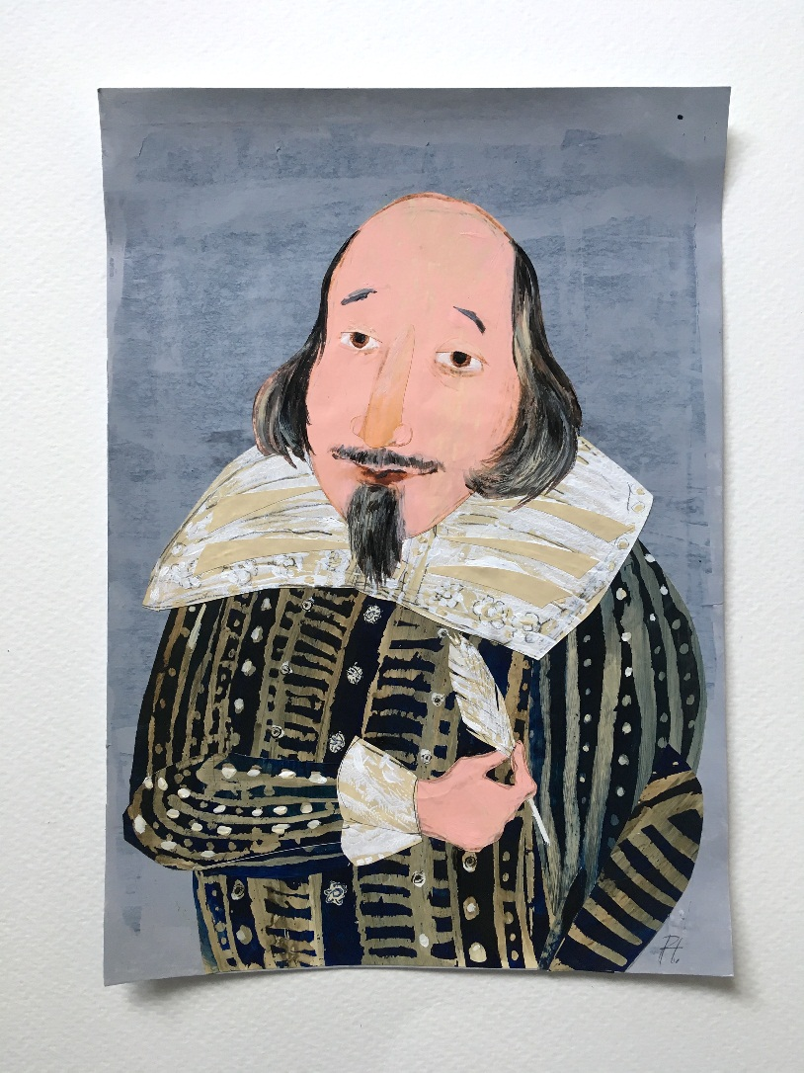
Creating a Shakespeare portrait
17. Here you go – my portrait of William Shakespeare!

