Slide 1

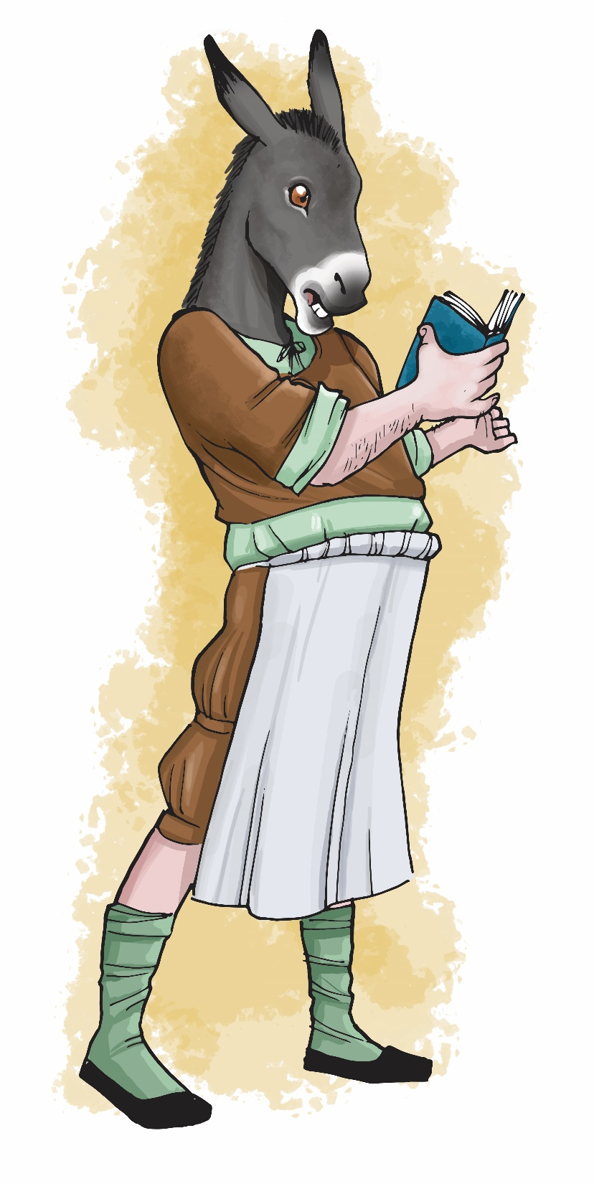


Making a Shakespeare Scrapbook

Slide 2
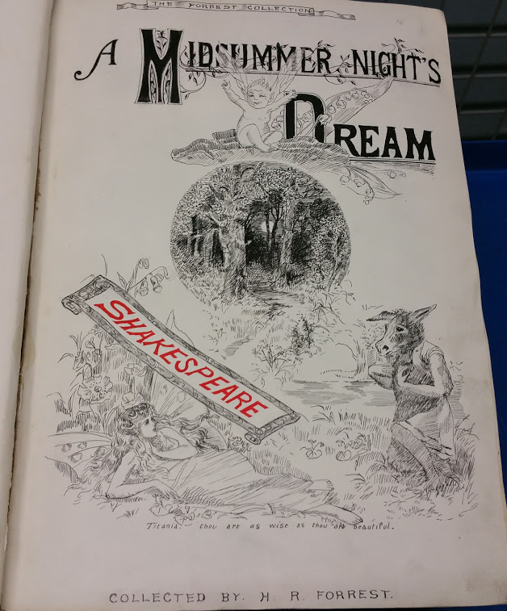
Do you like collecting things?
The Forrest collection is part of Birmingham Shakespeare Library and is a collection of scrapbooks created by Mr Henry R Forrest.
Mr Henry R Forrest loved collecting things to do with Shakespeare, especially beautiful drawings. Between 1830 and 1886 he filled up 76 scrapbooks with Shakespeare items. Since 1906 this entire collection has been looked after by Birmingham Libraries.

Slide 3
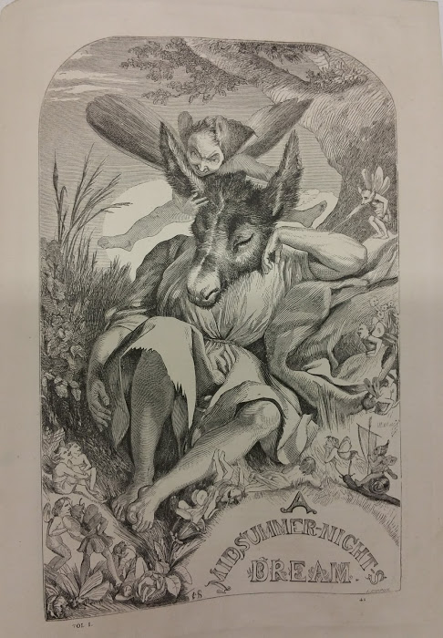
What’s inside the scrapbooks?
Among the many treasures that are inside the scrapbooks there are illustrations by well-known artists such as Henry Fuseli (1741-1825) and rare portraits of Shakespeare and other people from Shakespeare’s time.
They also contain portraits of Shakespearian actors and actresses as well as illustrations to each of the plays amongst other things.

Slide 4
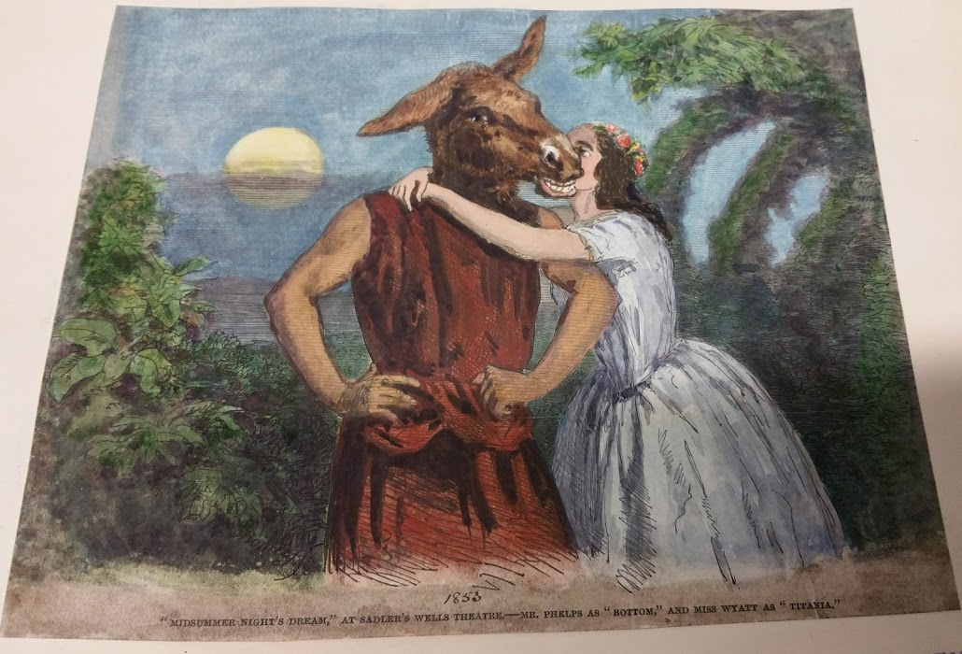
Hand-coloured by Mr Forrest
Some of the illustrations are taken or cut from Cassells editions of Shakespeare’s work (1860-1890) and then coloured in by hand by Mr Forrest. This is probably the case of the illustrations for A Midsummer Night’s Dream that you can see here and on the next page.

Slide 5
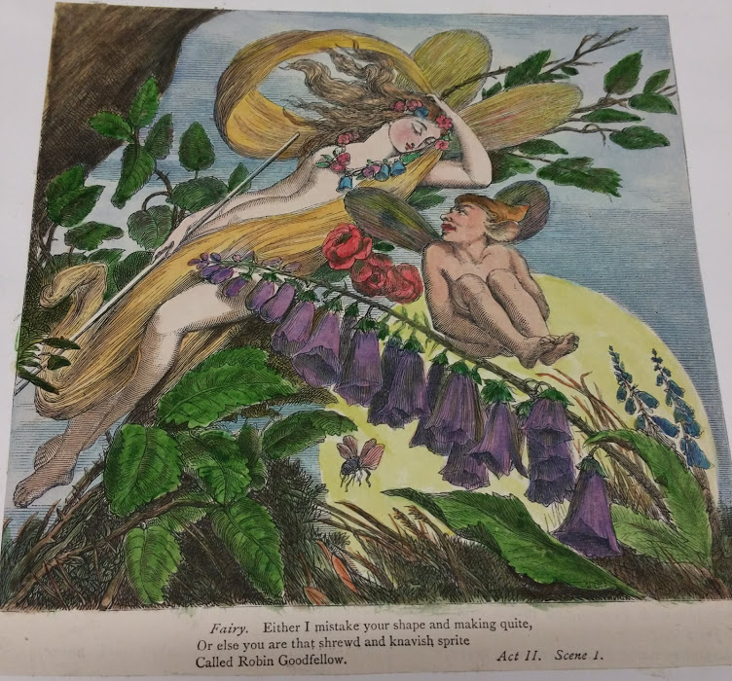
Henry Courtney Selous
The original illustrations of Cassells editions were by an artist called Henry Courtney Selous.

Slide 6
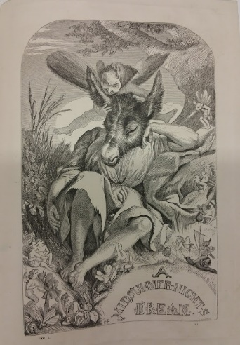
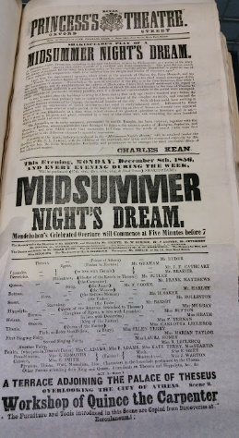



Make your own Shakespeare Scrapbook
Why not make your own Shakespeare Scrapbook? You can do this on your own, in a group, or as a whole class.

Slide 7
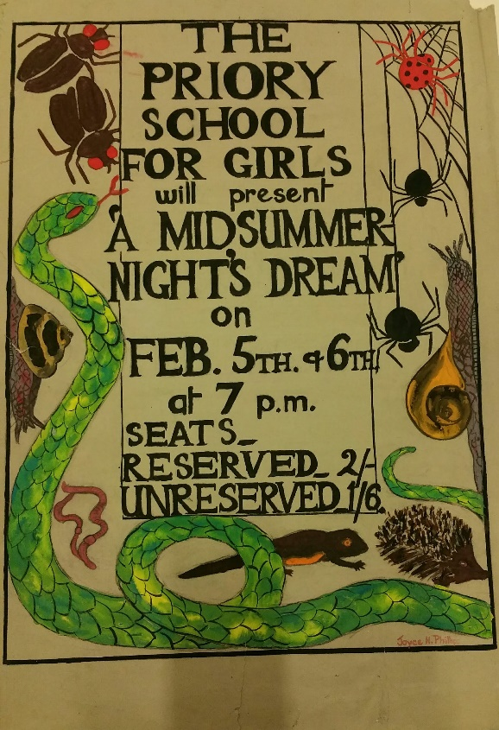
Plan your scrapbook
Decide what is going to be in your scrapbook – is it about Shakespeare’s life story or about one of his plays? Perhaps it is a scrapbook all about your Shakespeare Week learning?
What will you include? Here are some ideas:
paintings or illustrations of one of the plays;
a poster about your chosen play;
a ticket from a performance or assembly;
1930s poster from Priory Girls’ School

Slide 8
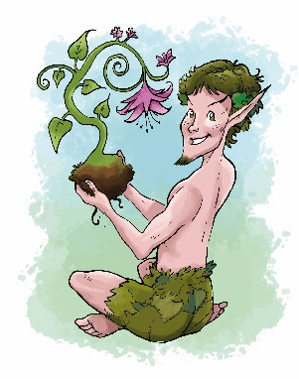
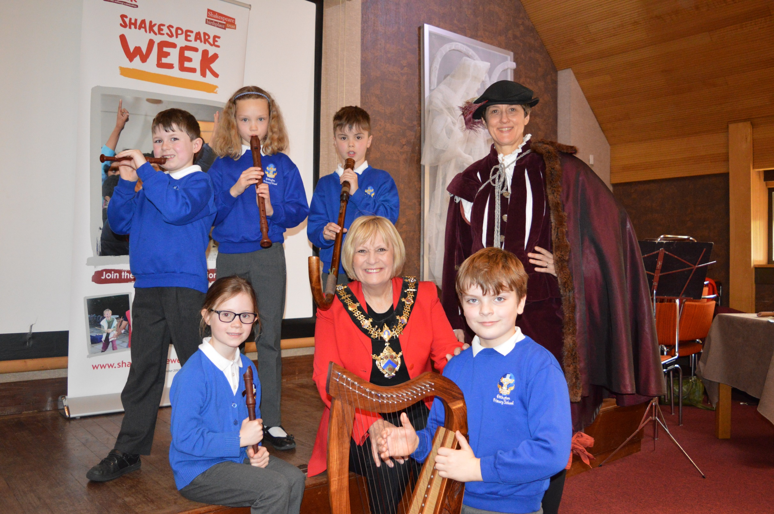
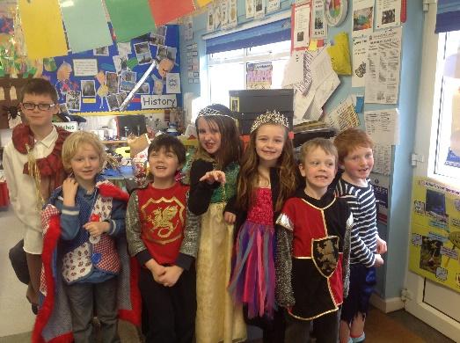
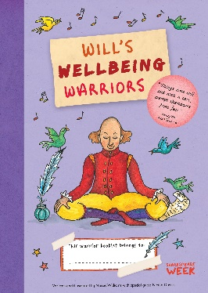
More scrapbook ideas
a bookmark;
photographs;
costume and set designs;
a script or short version of the play;
reviews of the play;
scanned book illustrations from your favourite Shakespeare books.
Create a beautiful cover for your scrapbook and share it with other classes or display it in your school library.

