Slide 1


Illustrating a plague doctor
‘Behind the scenes’ drawing techniques with Horrible Histories illustrator, Martin Brown

Slide 2


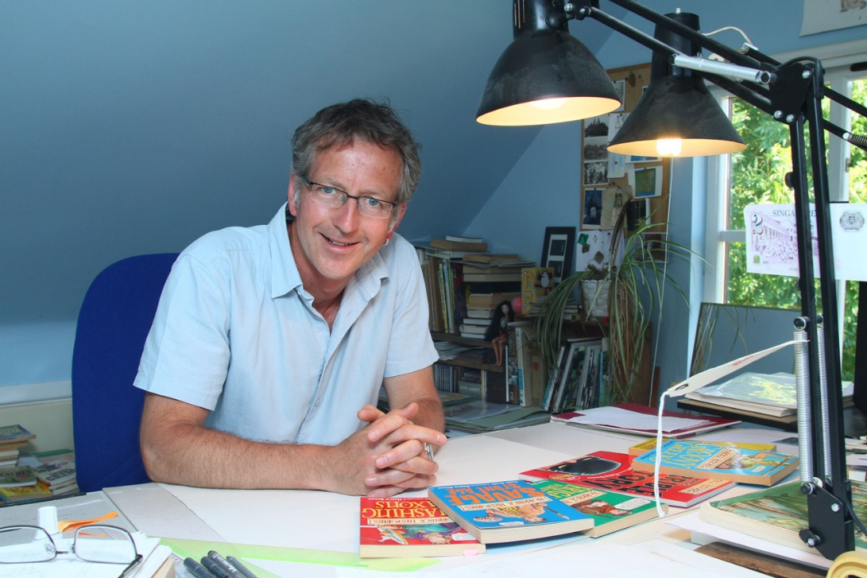
Who is Martin Brown?
“I am called the illustrator of the Horrible Histories - and I guess I am. I do draw the pictures for the books - which makes me the illustrator - but really, what I do is cartooning. Right from the start, my job was to write gags (jokes) and draw cartoons about history. Not to illustrate it accurately.”

Slide 3
The ideas stage
“Drawing a Horrible Histories cartoon doesn’t start with a pencil, it doesn’t even start with a blank piece of paper. It begins with reading.
“If I need to draw - I don’t know - a plague doctor - the very first thing I have to do is read about plague doctors. That’s where the ideas will come from. I could merely copy an old picture of a 17th century doctor but there wouldn’t be much point in that. If I want to add something about plague medicine, like a joke or a comment, I have to know about it first.”

Slide 4
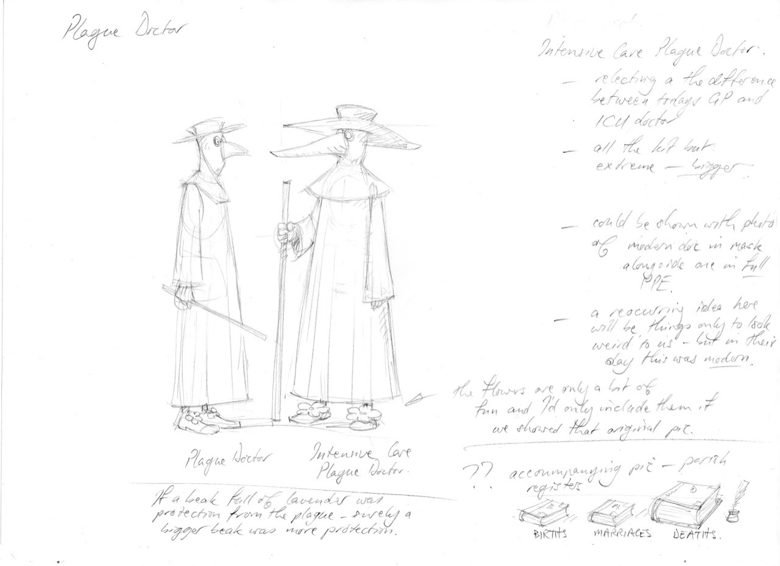
The rough drawing
“After reading, it’s writing. I have to decide what the joke or comment will be and what the cartoon will look like.”
“Then I get drawing - usually a rough sketch to start with - on thin, cheap paper. It helps me finalise the positions of things before I begin the final version.”
Illustrations copyright © Martin Brown

Slide 5
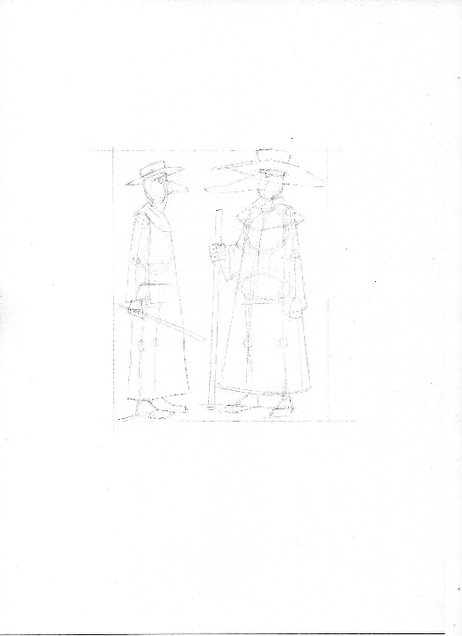
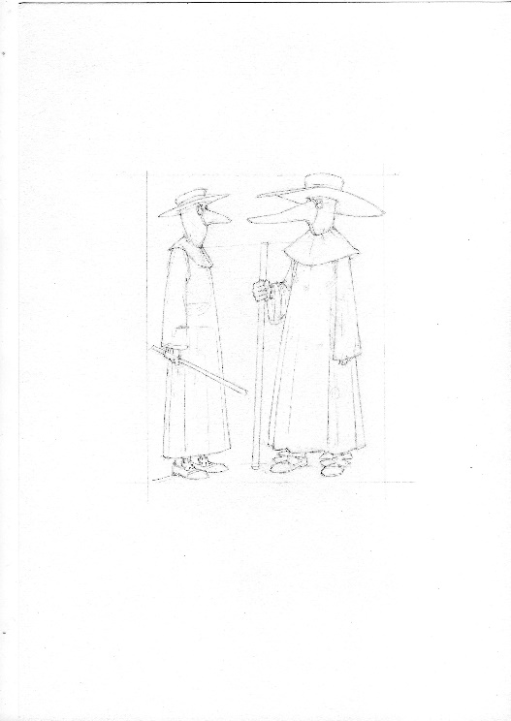
Step by step…
“When I’m happy with the rough I put it onto my light-box with a sheet of cartridge paper over the top. That way the rough shows through and I can copy it onto the good paper with pencil without having to start from scratch.”
“Once the basic shapes and details are down I finish the pencilling without the light-box.”
Illustrations copyright © Martin Brown

Slide 6
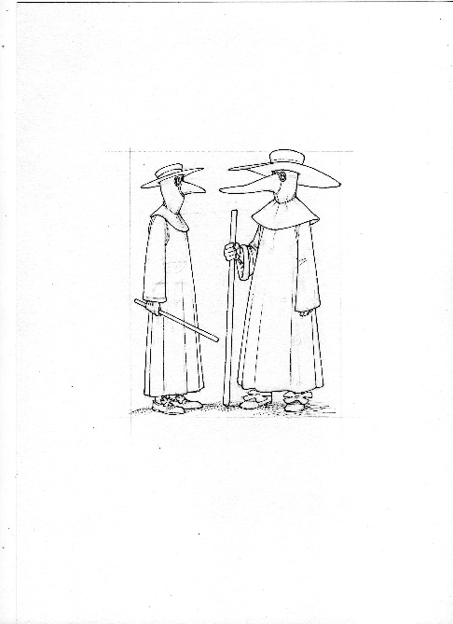
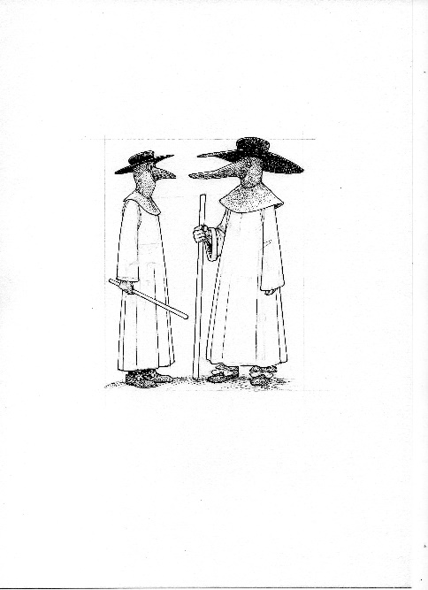
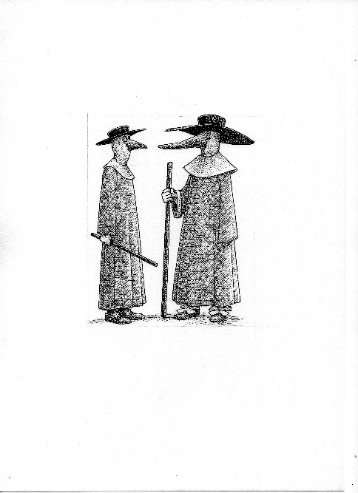
Inking up…
“Finally it’s time for ink. I go over all the pencil lines and then ‘colour-in’ the bits I want to be darker with cross-hatching - close and multi-layered for dark; open and single layered for light.”
Illustrations copyright © Martin Brown

Slide 7
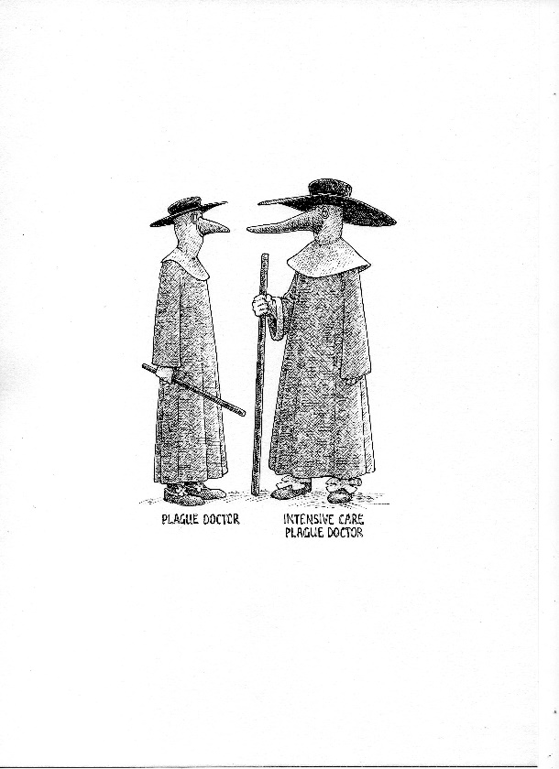
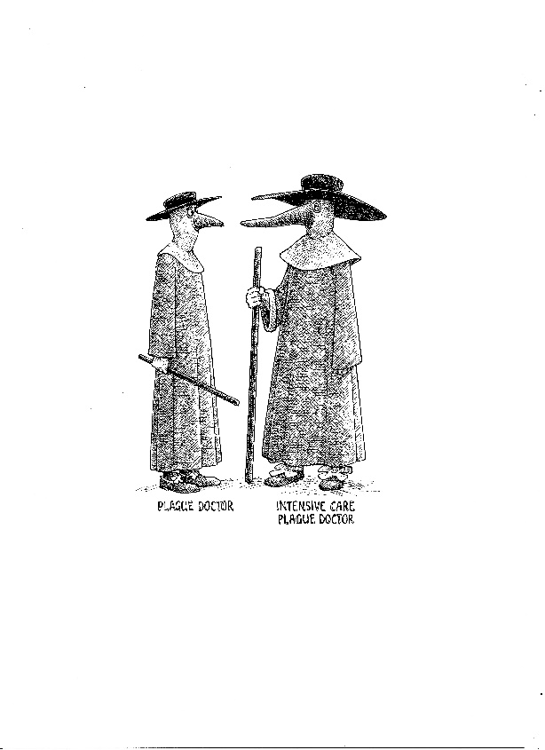
Final touches
“When the ink is dry, I rub out any pencil line still showing. And perhaps maybe sometimes - make a correction with Tippex.
No-one’s perfect!”
Illustrations copyright © Martin Brown

