Slide 1


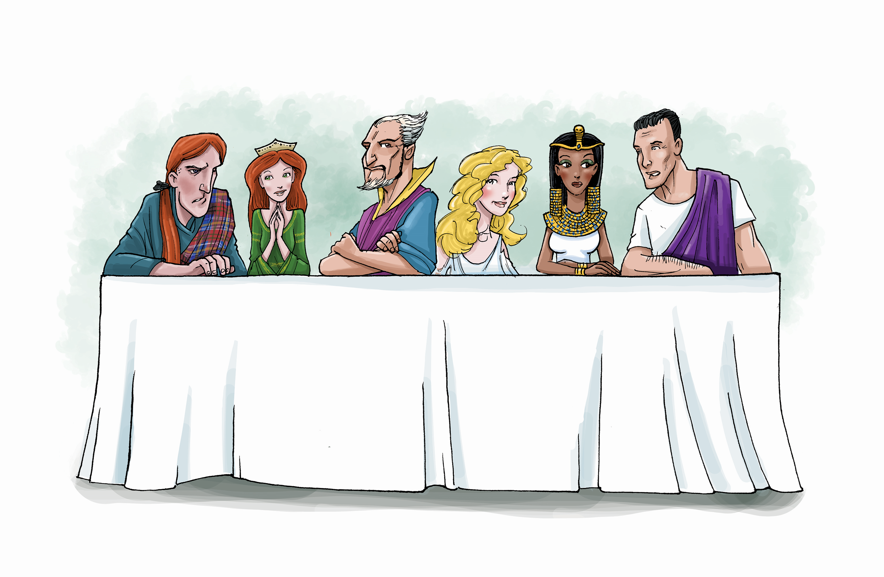
Costume Design
Character Gallery

Slide 2
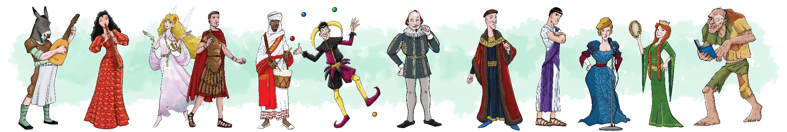
Shakespeare Week 2025
Take a look at the images on the next few slides. They show a selection of Shakespeare’s characters and some of the ways that they have been depicted.
You might use the images to give you ideas for your own design!

Slide 3
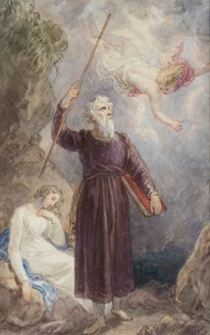
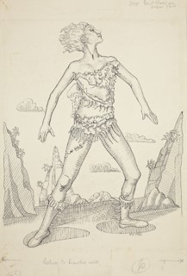
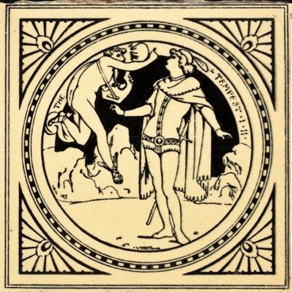
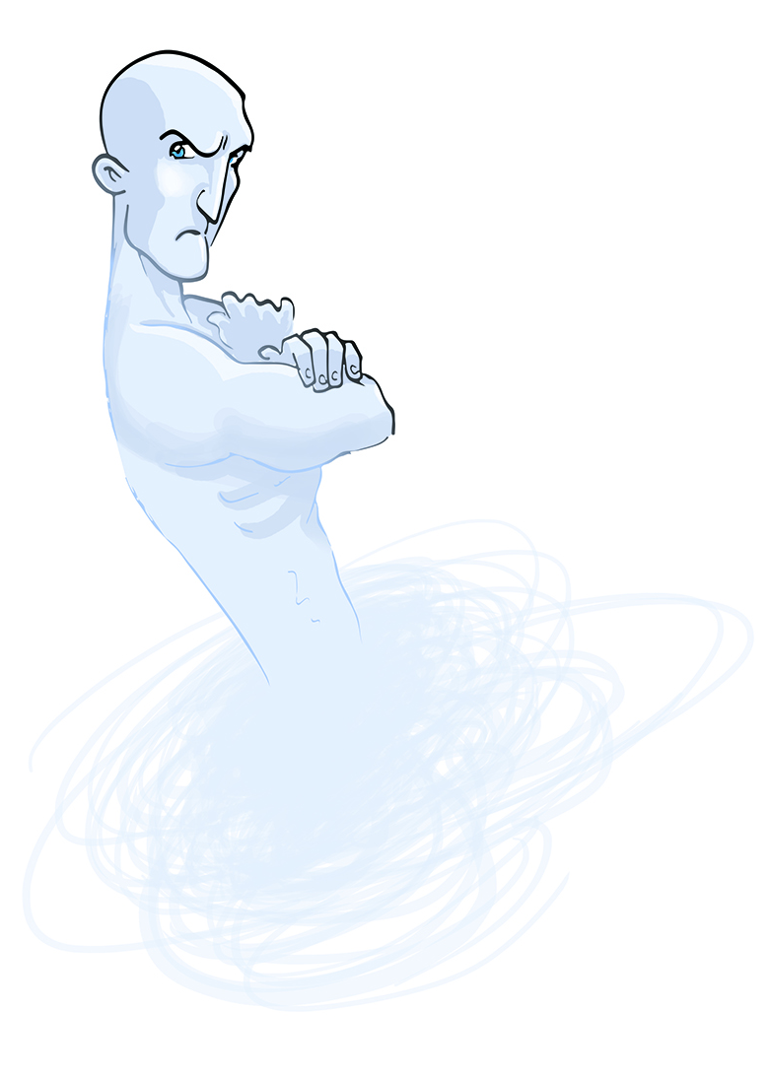
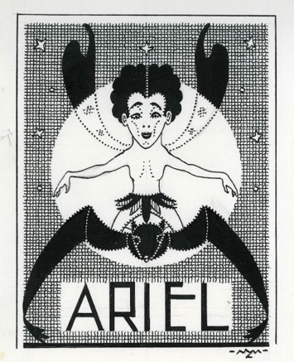
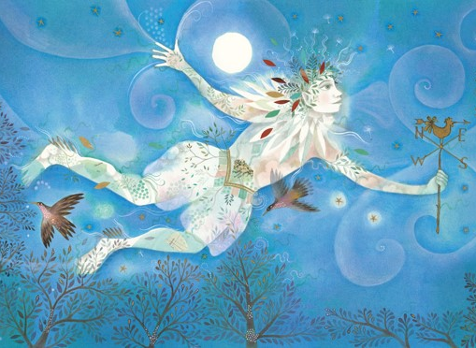
Ariel
(Play: The Tempest)
© Jane Ray
Image Courtesy of the Shakespeare Birthplace Trust
Image Courtesy of the Shakespeare Birthplace Trust
© Shakespeare Birthplace Trust
Image Courtesy of the Shakespeare Birthplace Trust
© Waldo Lanchester

Slide 4
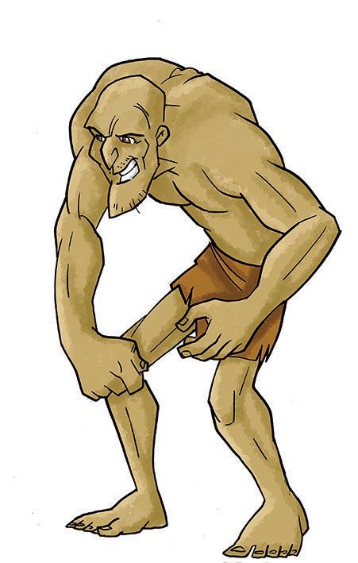
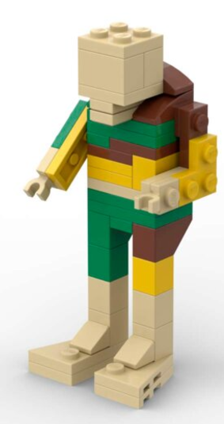
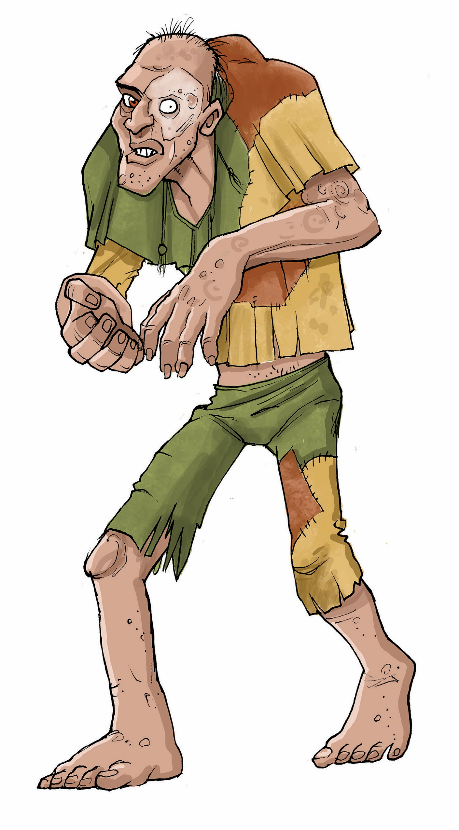
Caliban
(Play: The Tempest)
© Shakespeare Birthplace Trust
© Brick Galleria
© 2020 Lego Group
© Shakespeare Birthplace Trust

Slide 5
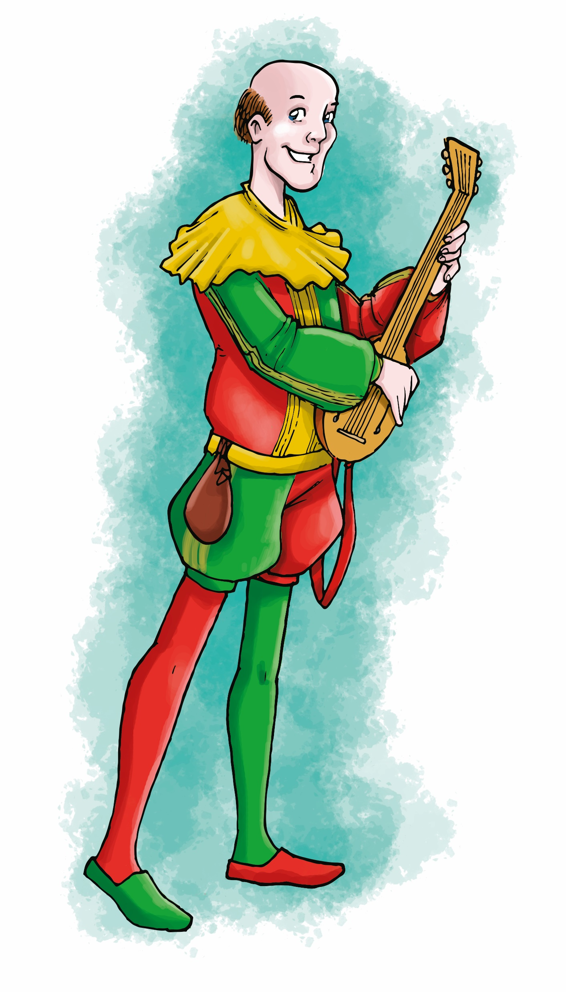
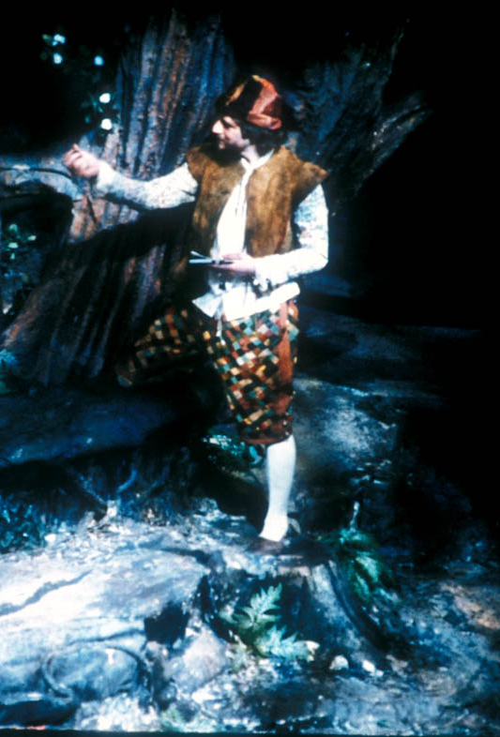
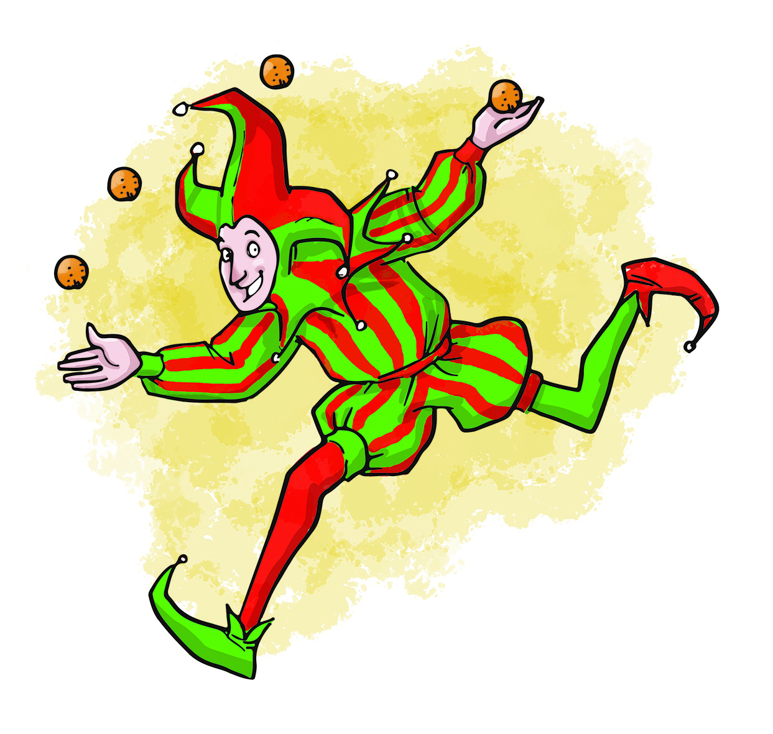
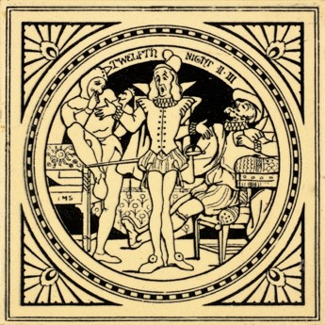
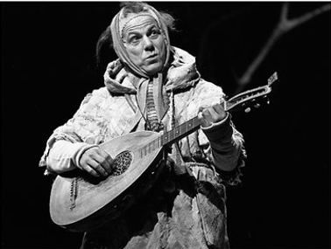
Feste
(Play: Twelfth Night)
© Shakespeare Birthplace Trust
©Shakespeare Birthplace Trust (SBT Collections: GL1/1/1979/TWE1)
Image Courtesy of the Shakespeare Birthplace Trust (SBT Collections: SBT 2016-13/4)
Image Courtesy of the Shakespeare Birthplace Trust
© Shakespeare Birthplace Trust

Slide 6
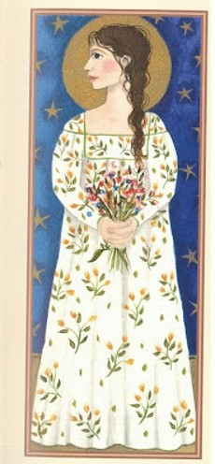
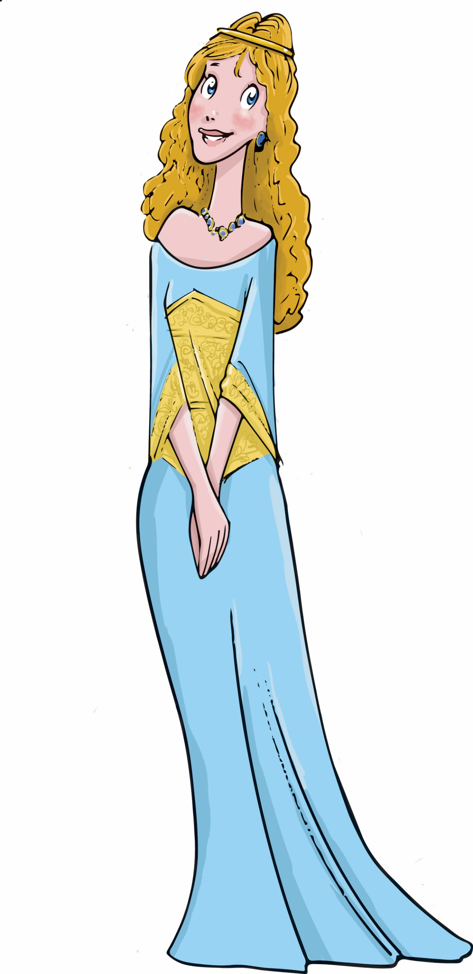
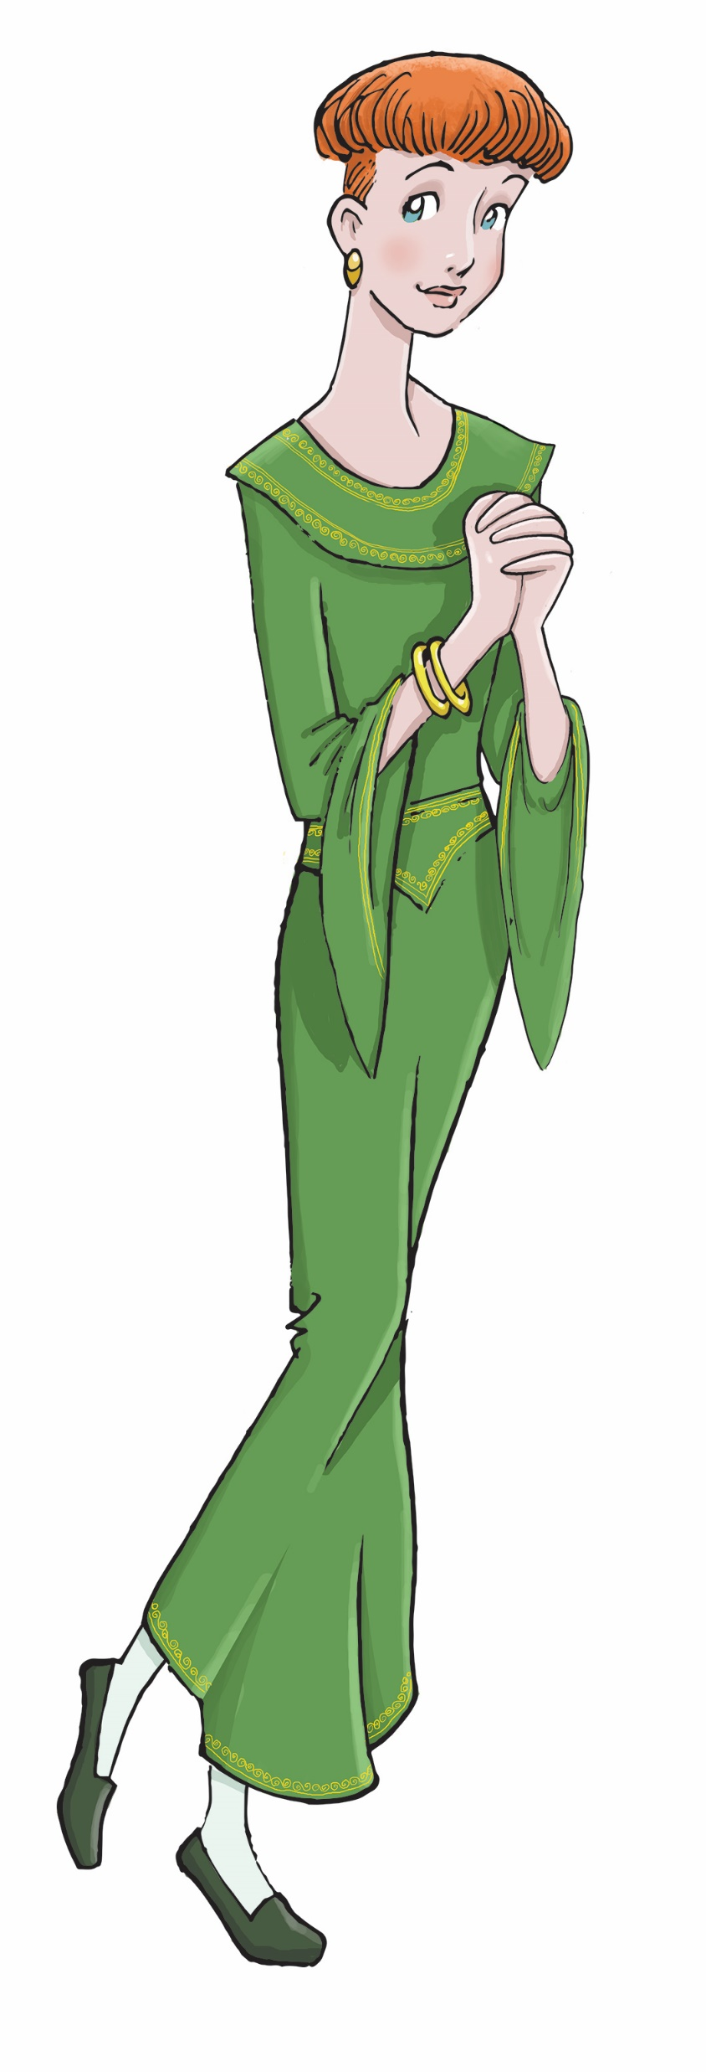
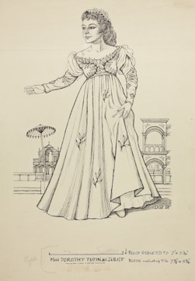
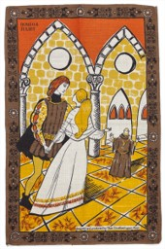
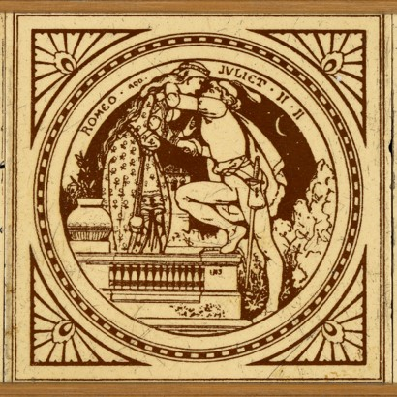
Juliet
(Play: Romeo & Juliet)
Image Courtesy of the Shakespeare Birthplace Trust (SBT Collections: SBT 2023-3/1)
©Tibor Reich Estate (SBT Collections: SBT 1972-14/3)
© Shakespeare Birthplace Trust
© Shakespeare Birthplace Trust
© Waldo Lanchester Estate (SBT Collections: SBT 2017-13/52)
© Jane Ray

Slide 7
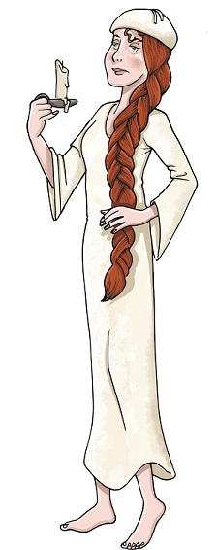
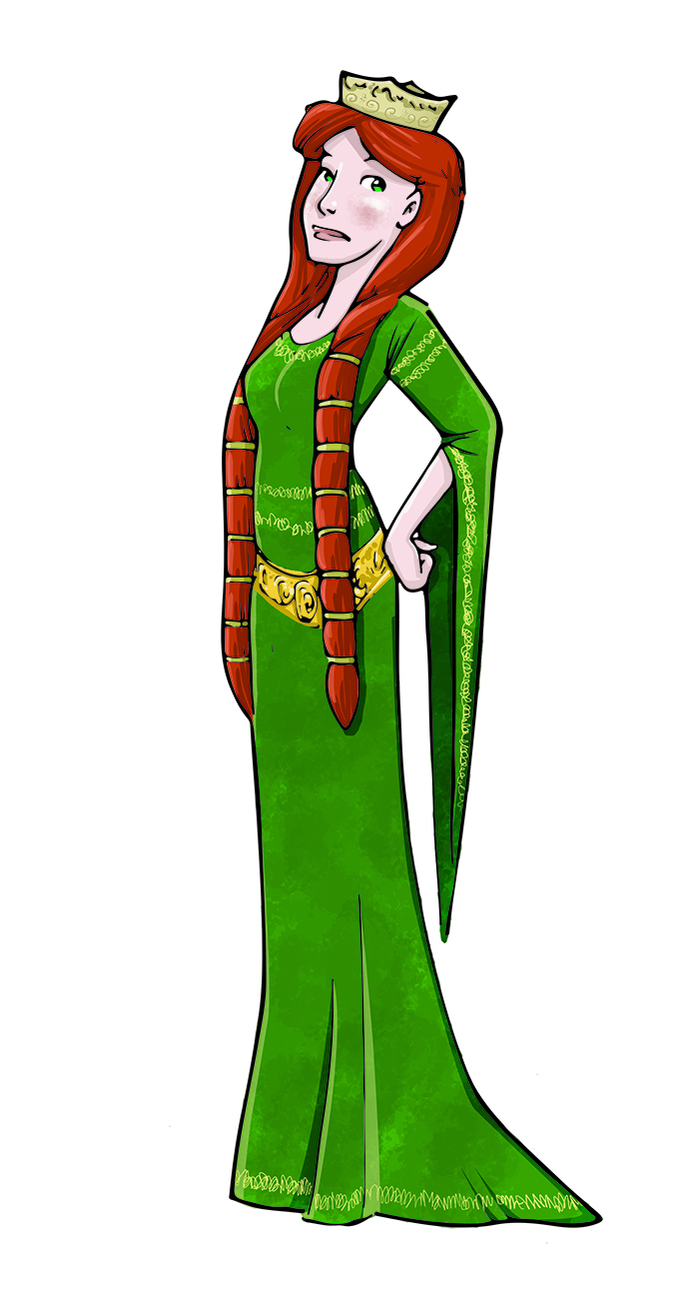
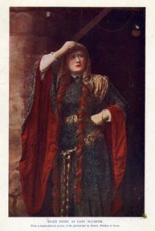
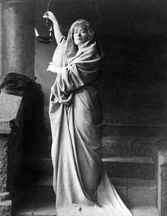
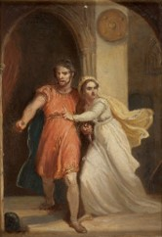
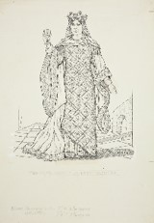
Lady Macbeth
(Play: Macbeth)
Image Courtesy of the Shakespeare Birthplace Trust
Image Copyright of Waldo Lanchester Estate (SBT Collections: SBT 2017-13/29)
© Shakespeare Birthplace Trust
Image Courtesy of the Shakespeare Birthplace Trust
Image Courtesy of the Shakespeare Birthplace Trust (SBT Collections: PC 72.19 1888 London LYC)
© Shakespeare Birthplace Trust

Slide 8
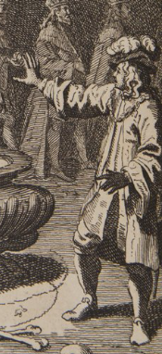
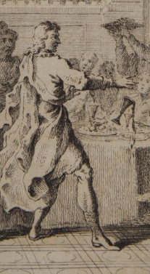
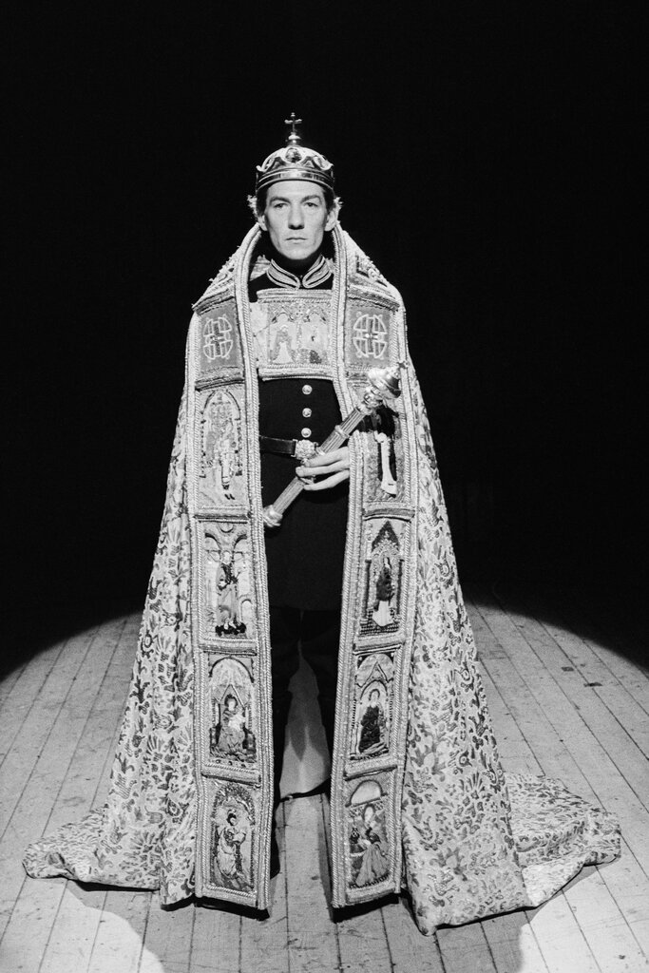
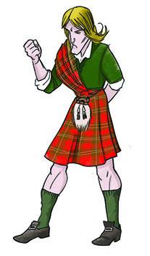
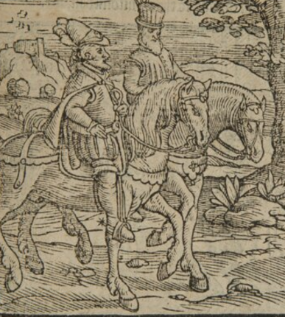
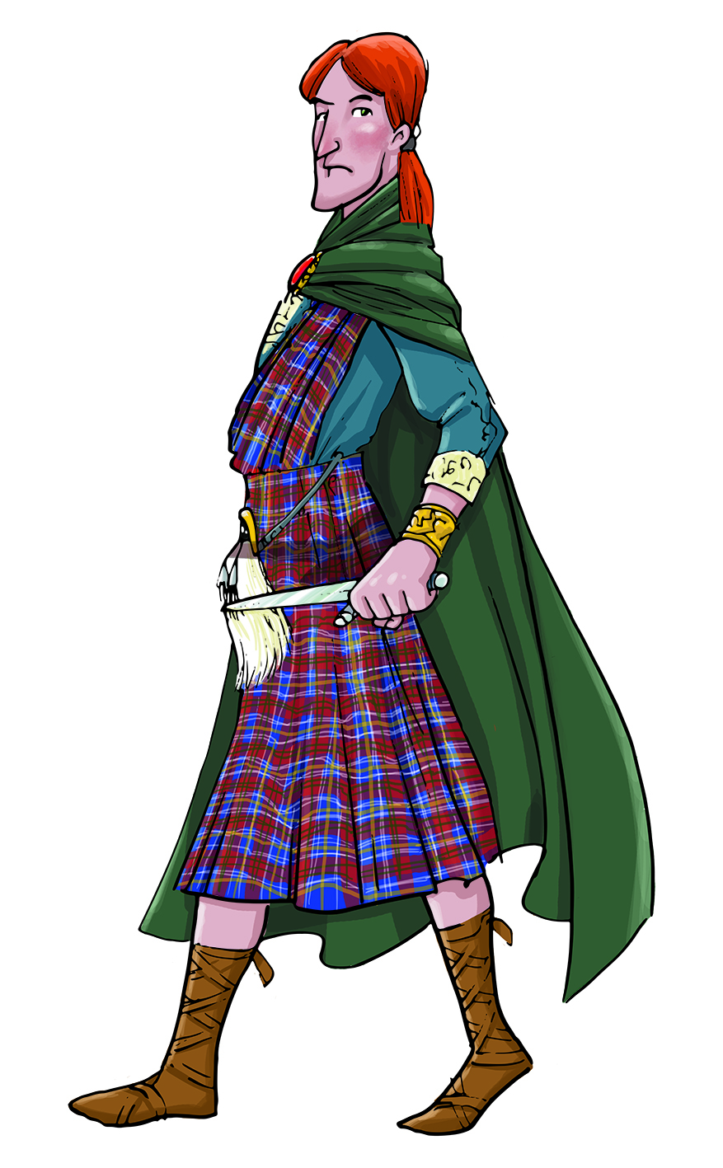
Macbeth
(Play: Macbeth)
© Shakespeare Birthplace Trust
© Shakespeare Birthplace Trust
© Shakespeare Birthplace Trust
© Shakespeare Birthplace Trust
Joe Cocks Studio Collection © Shakespeare Birthplace Trust
© Shakespeare Birthplace Trust

Slide 9
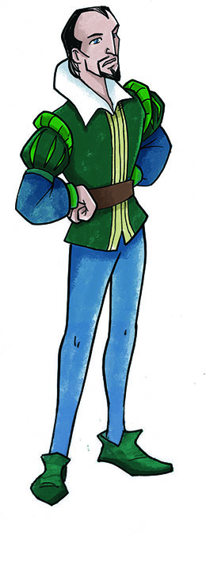
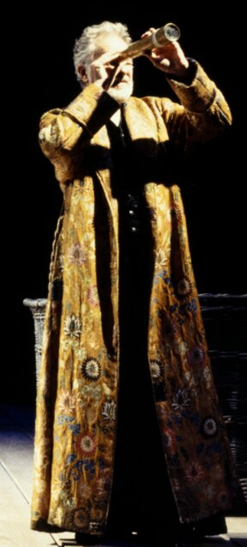
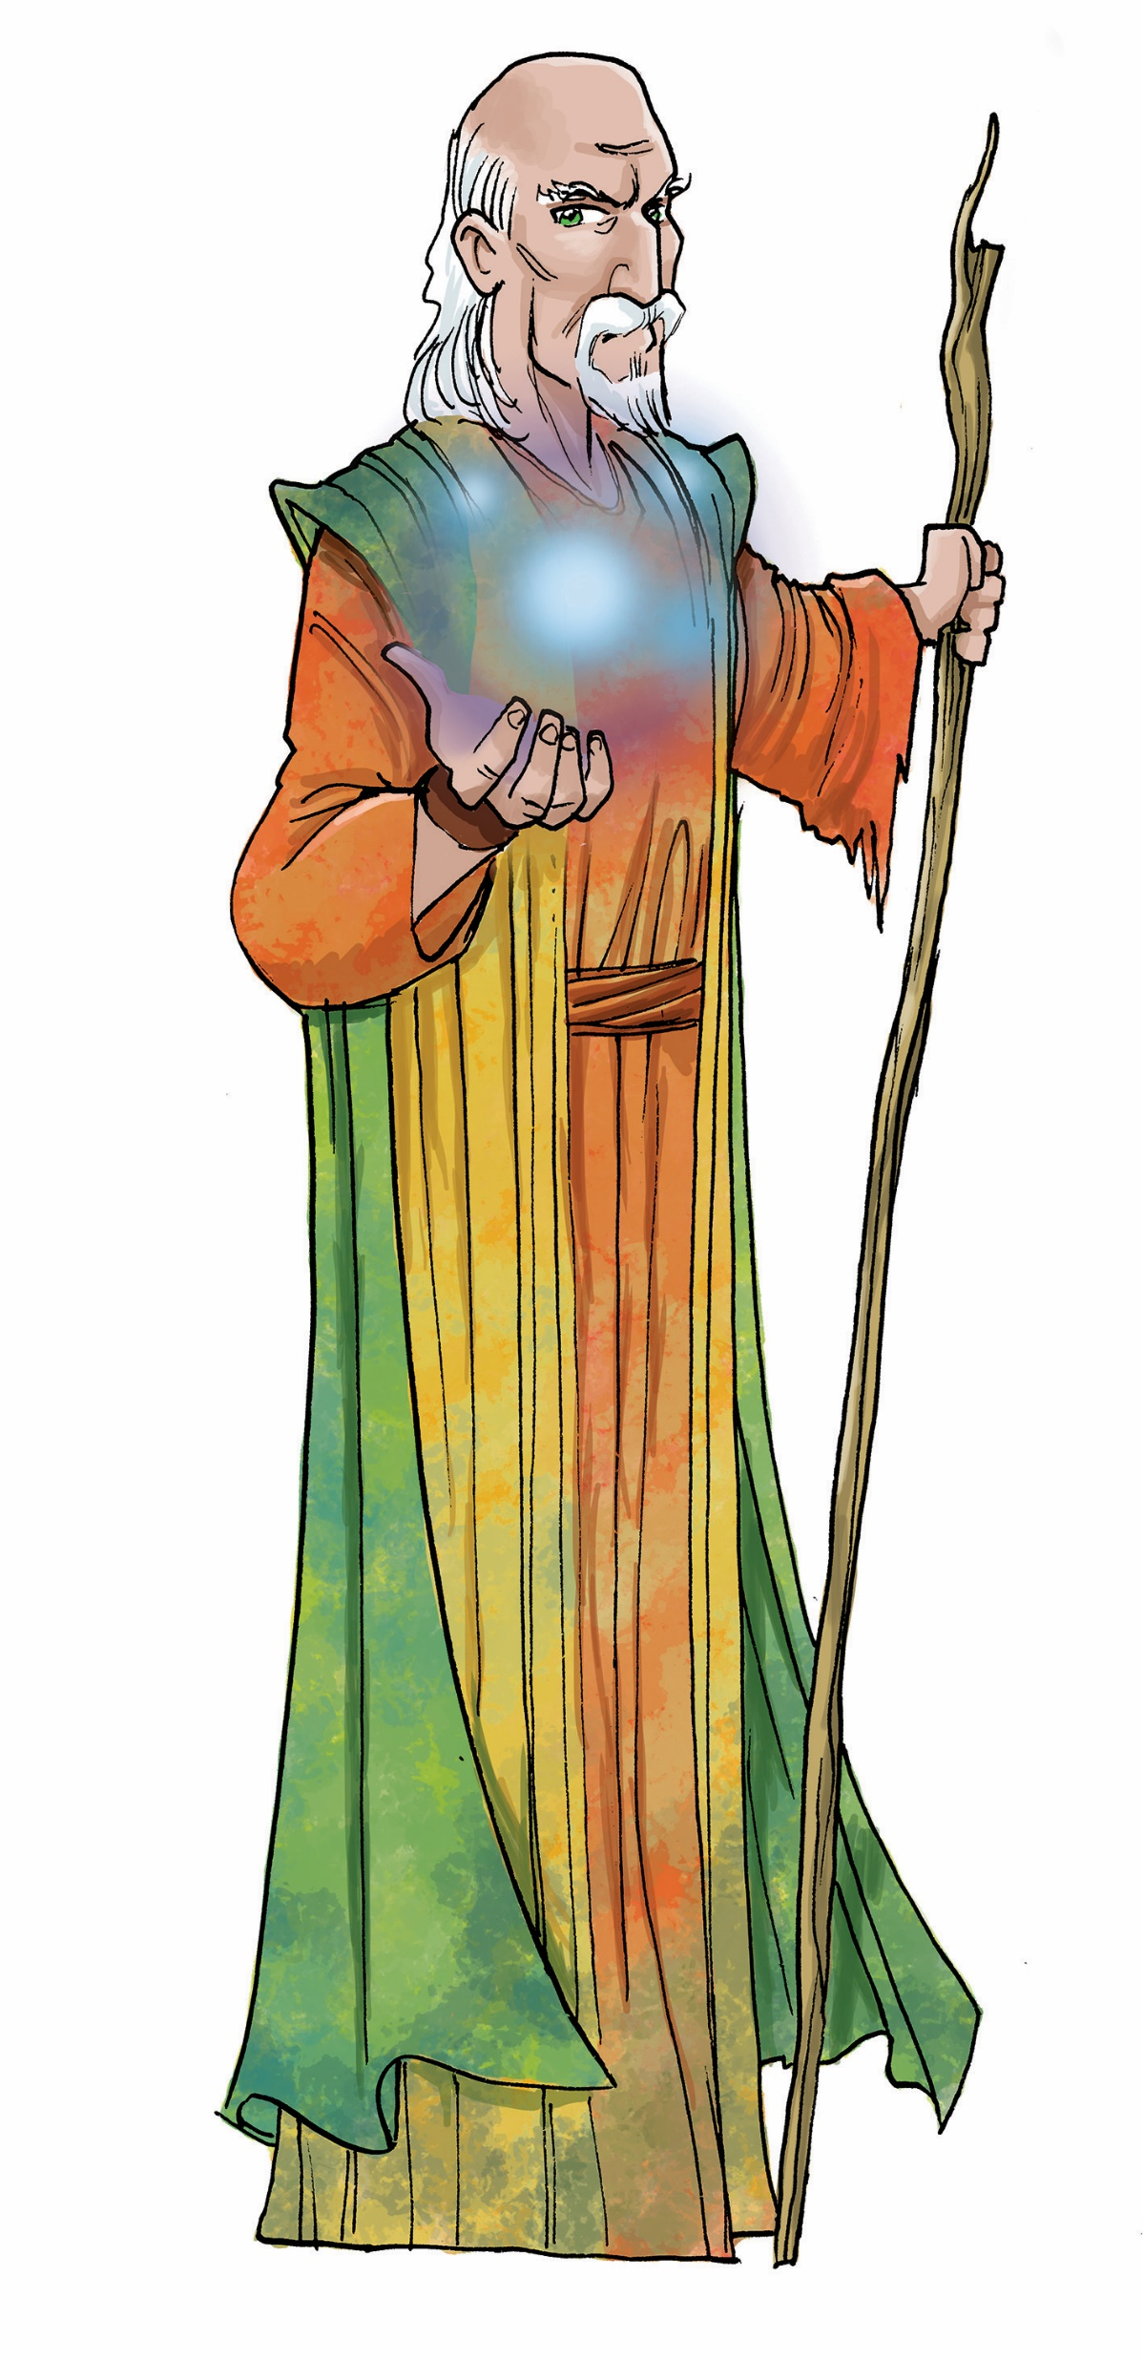
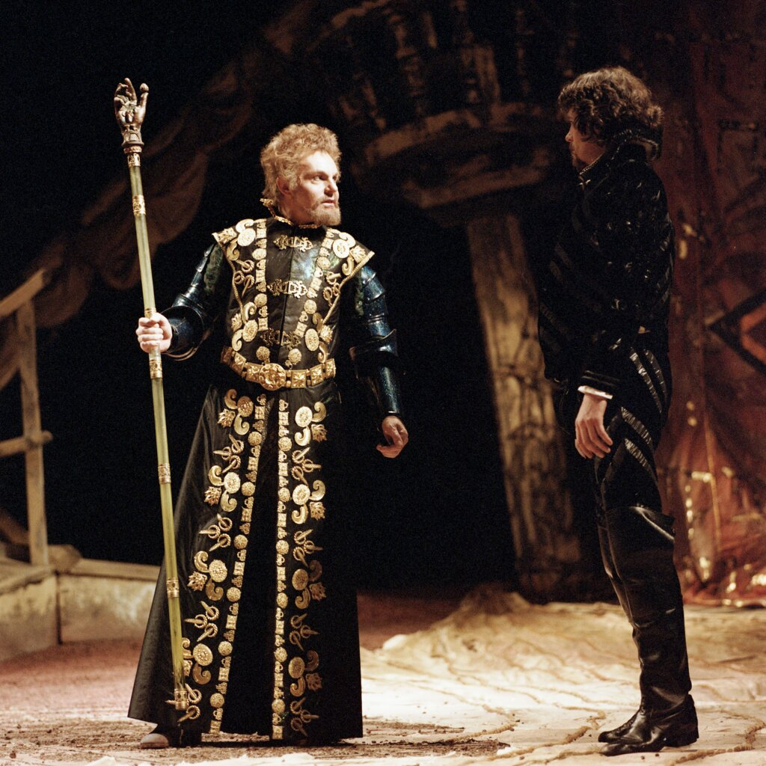
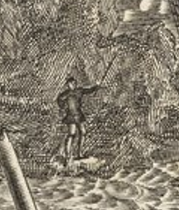
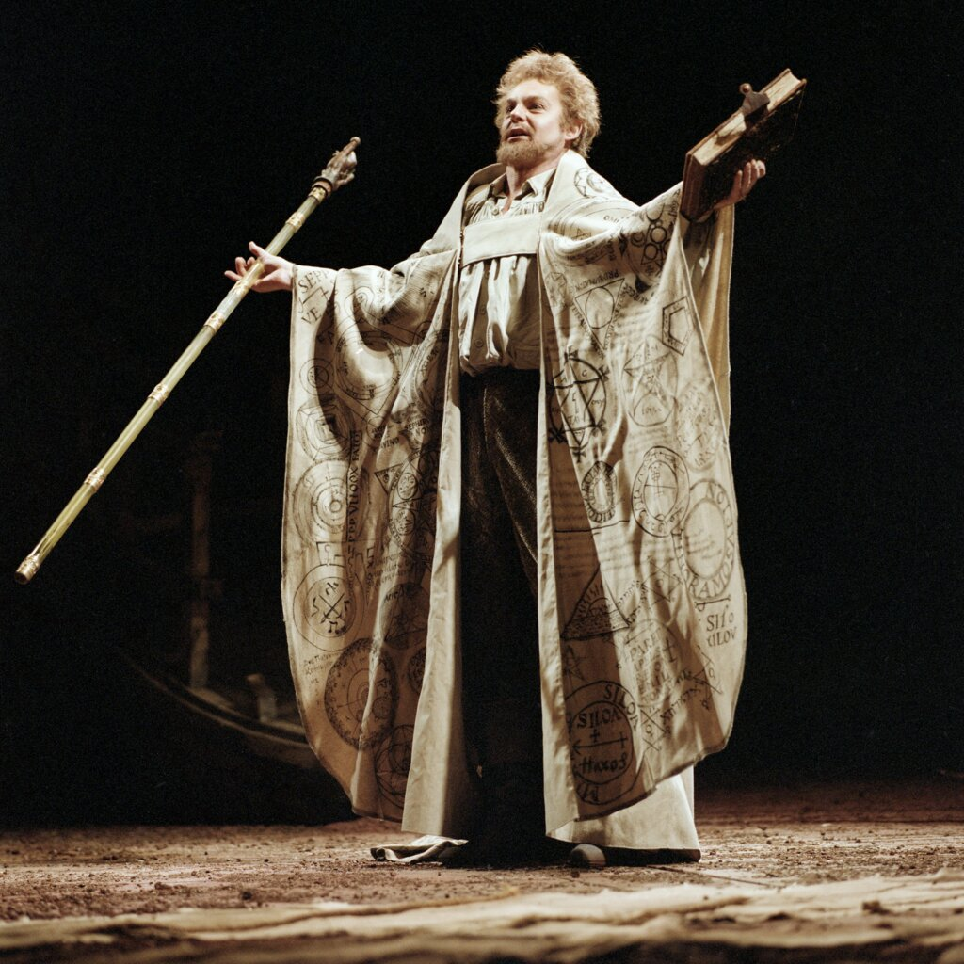
Prospero
(Play: The Tempest)
Joe Cocks Studio Collection © Shakespeare Birthplace Trust
© Shakespeare Birthplace Trust
Joe Cocks Studio Collection © Shakespeare Birthplace Trust
Malcolm Davies © Shakespeare Birthplace Trust
© Shakespeare Birthplace Trust
© Shakespeare Birthplace Trust

Slide 10
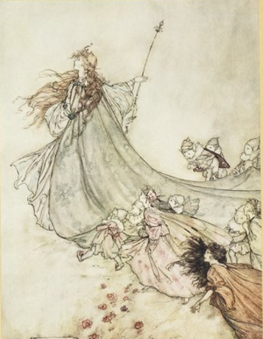
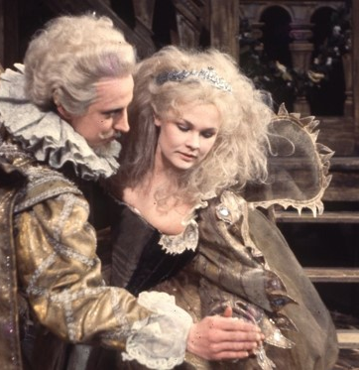
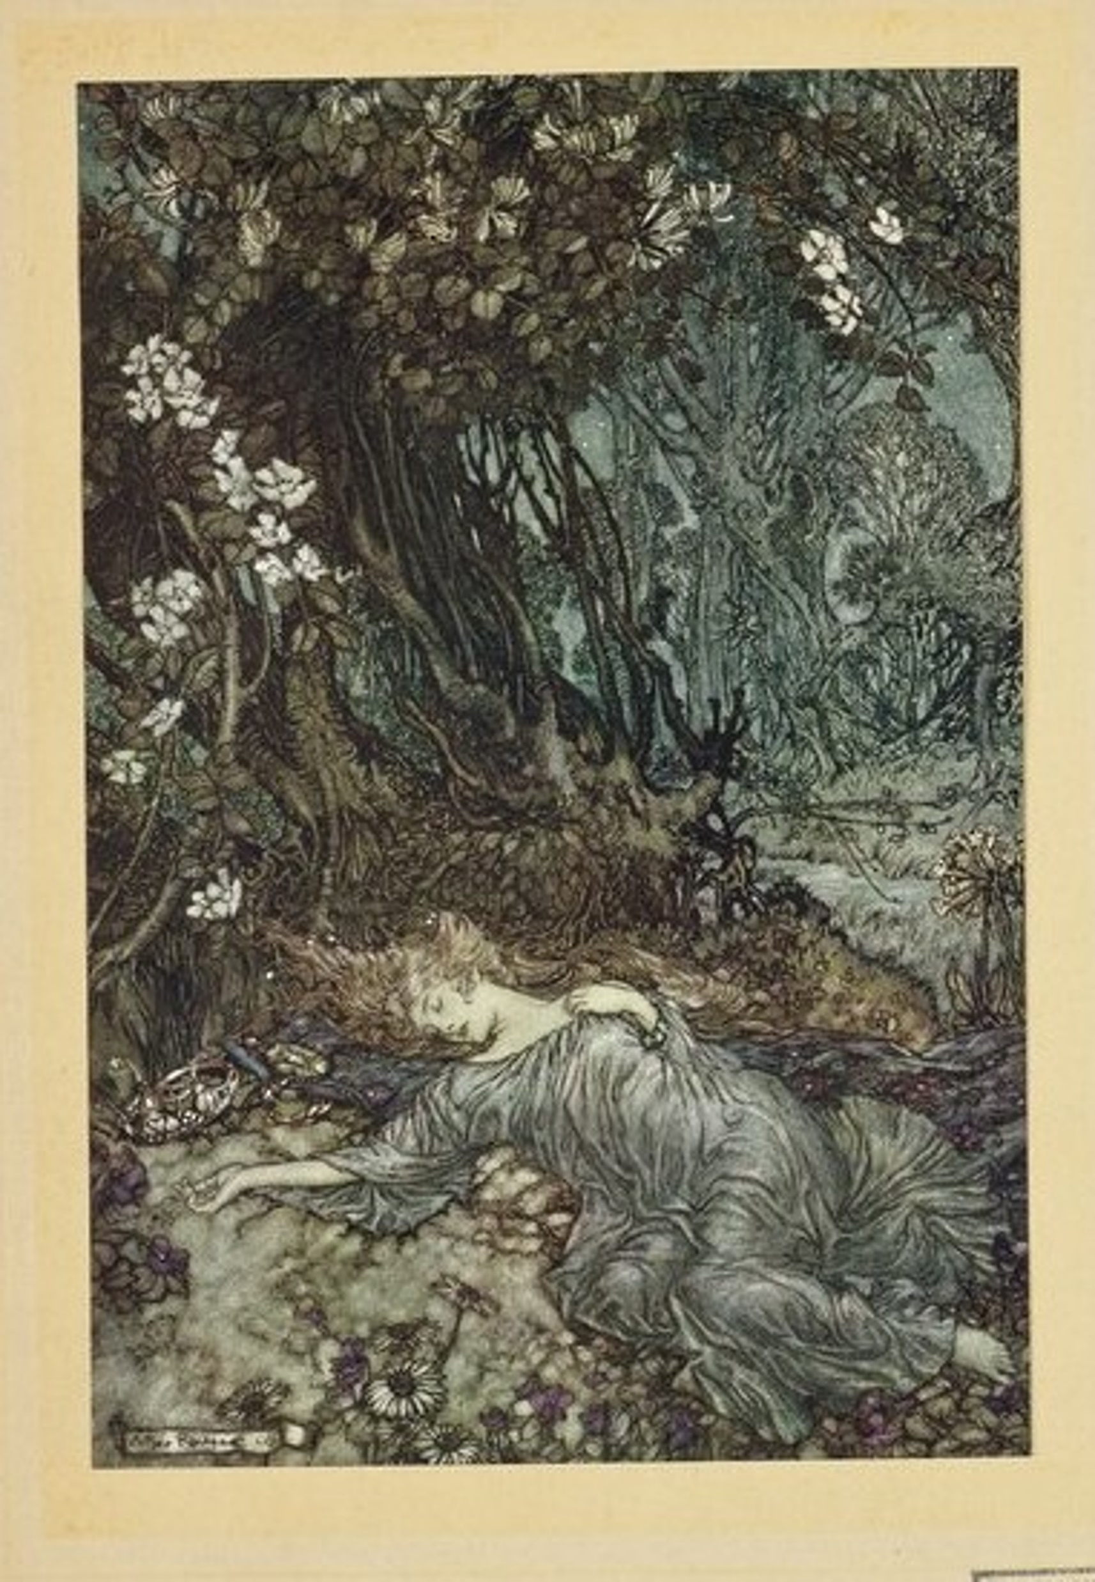
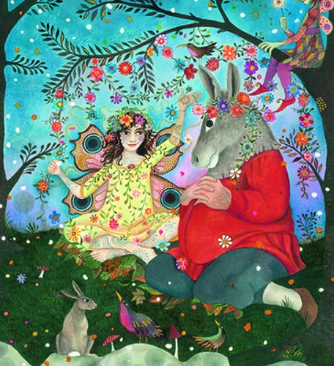
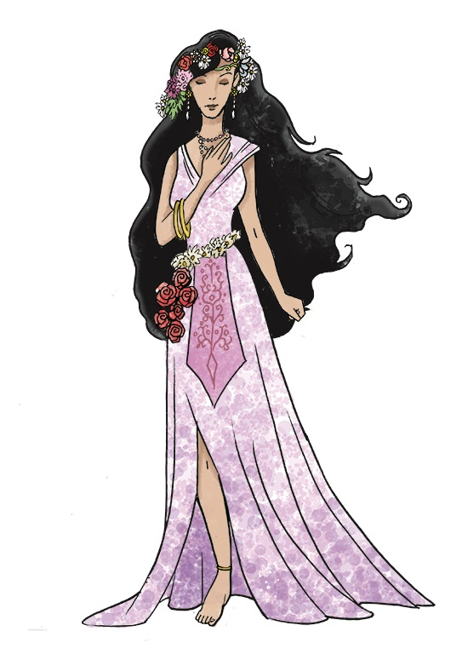
Titania
(Play: A Midsummer Night’s Dream)
© Jane Ray
Thomas Holte © Shakespeare Birthplace Trust
© Shakespeare Birthplace Trust
© Shakespeare Birthplace Trust
© Shakespeare Birthplace Trust

Slide 11
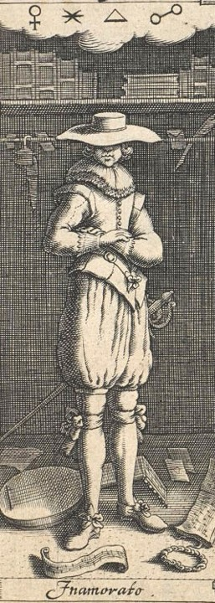
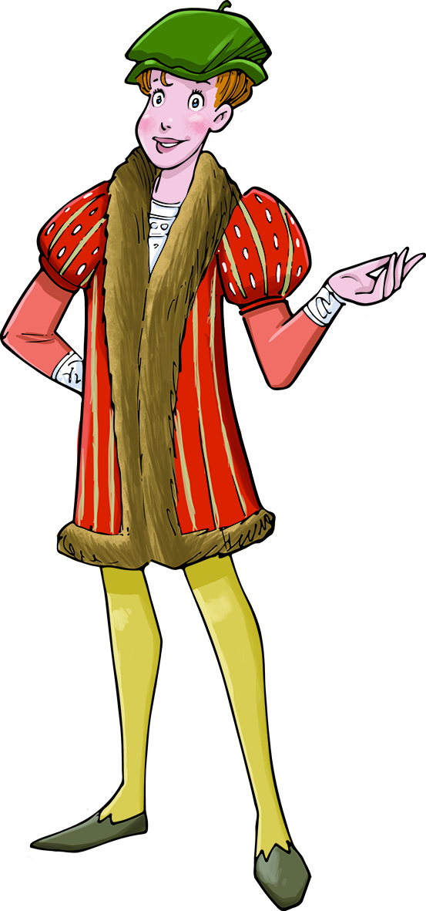
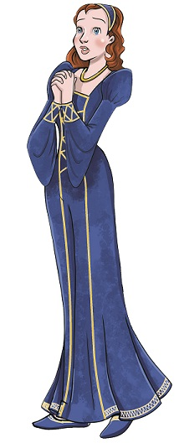
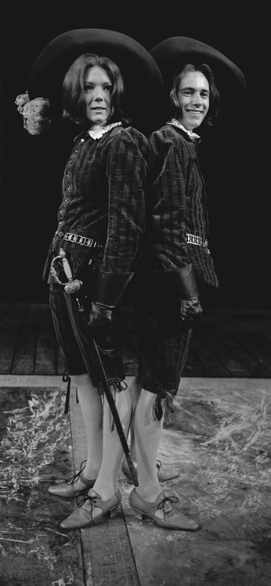
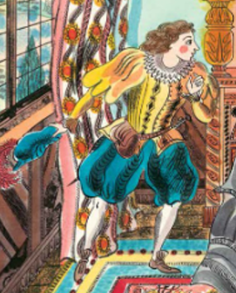

Viola
(Play: Twelfth Night)
© Jane Ray
© Emily Sutton
© Shakespeare Birthplace Trust
Image Courtesy of the Shakespeare Birthplace Trust (SBT Collections: SROS95.1, 83080686)
© Shakespeare Birthplace Trust
Image Copyright of the Shakespeare Birthplace Trust (SBT Collections: GL1/1/1966/TWE1)

